Slide 1
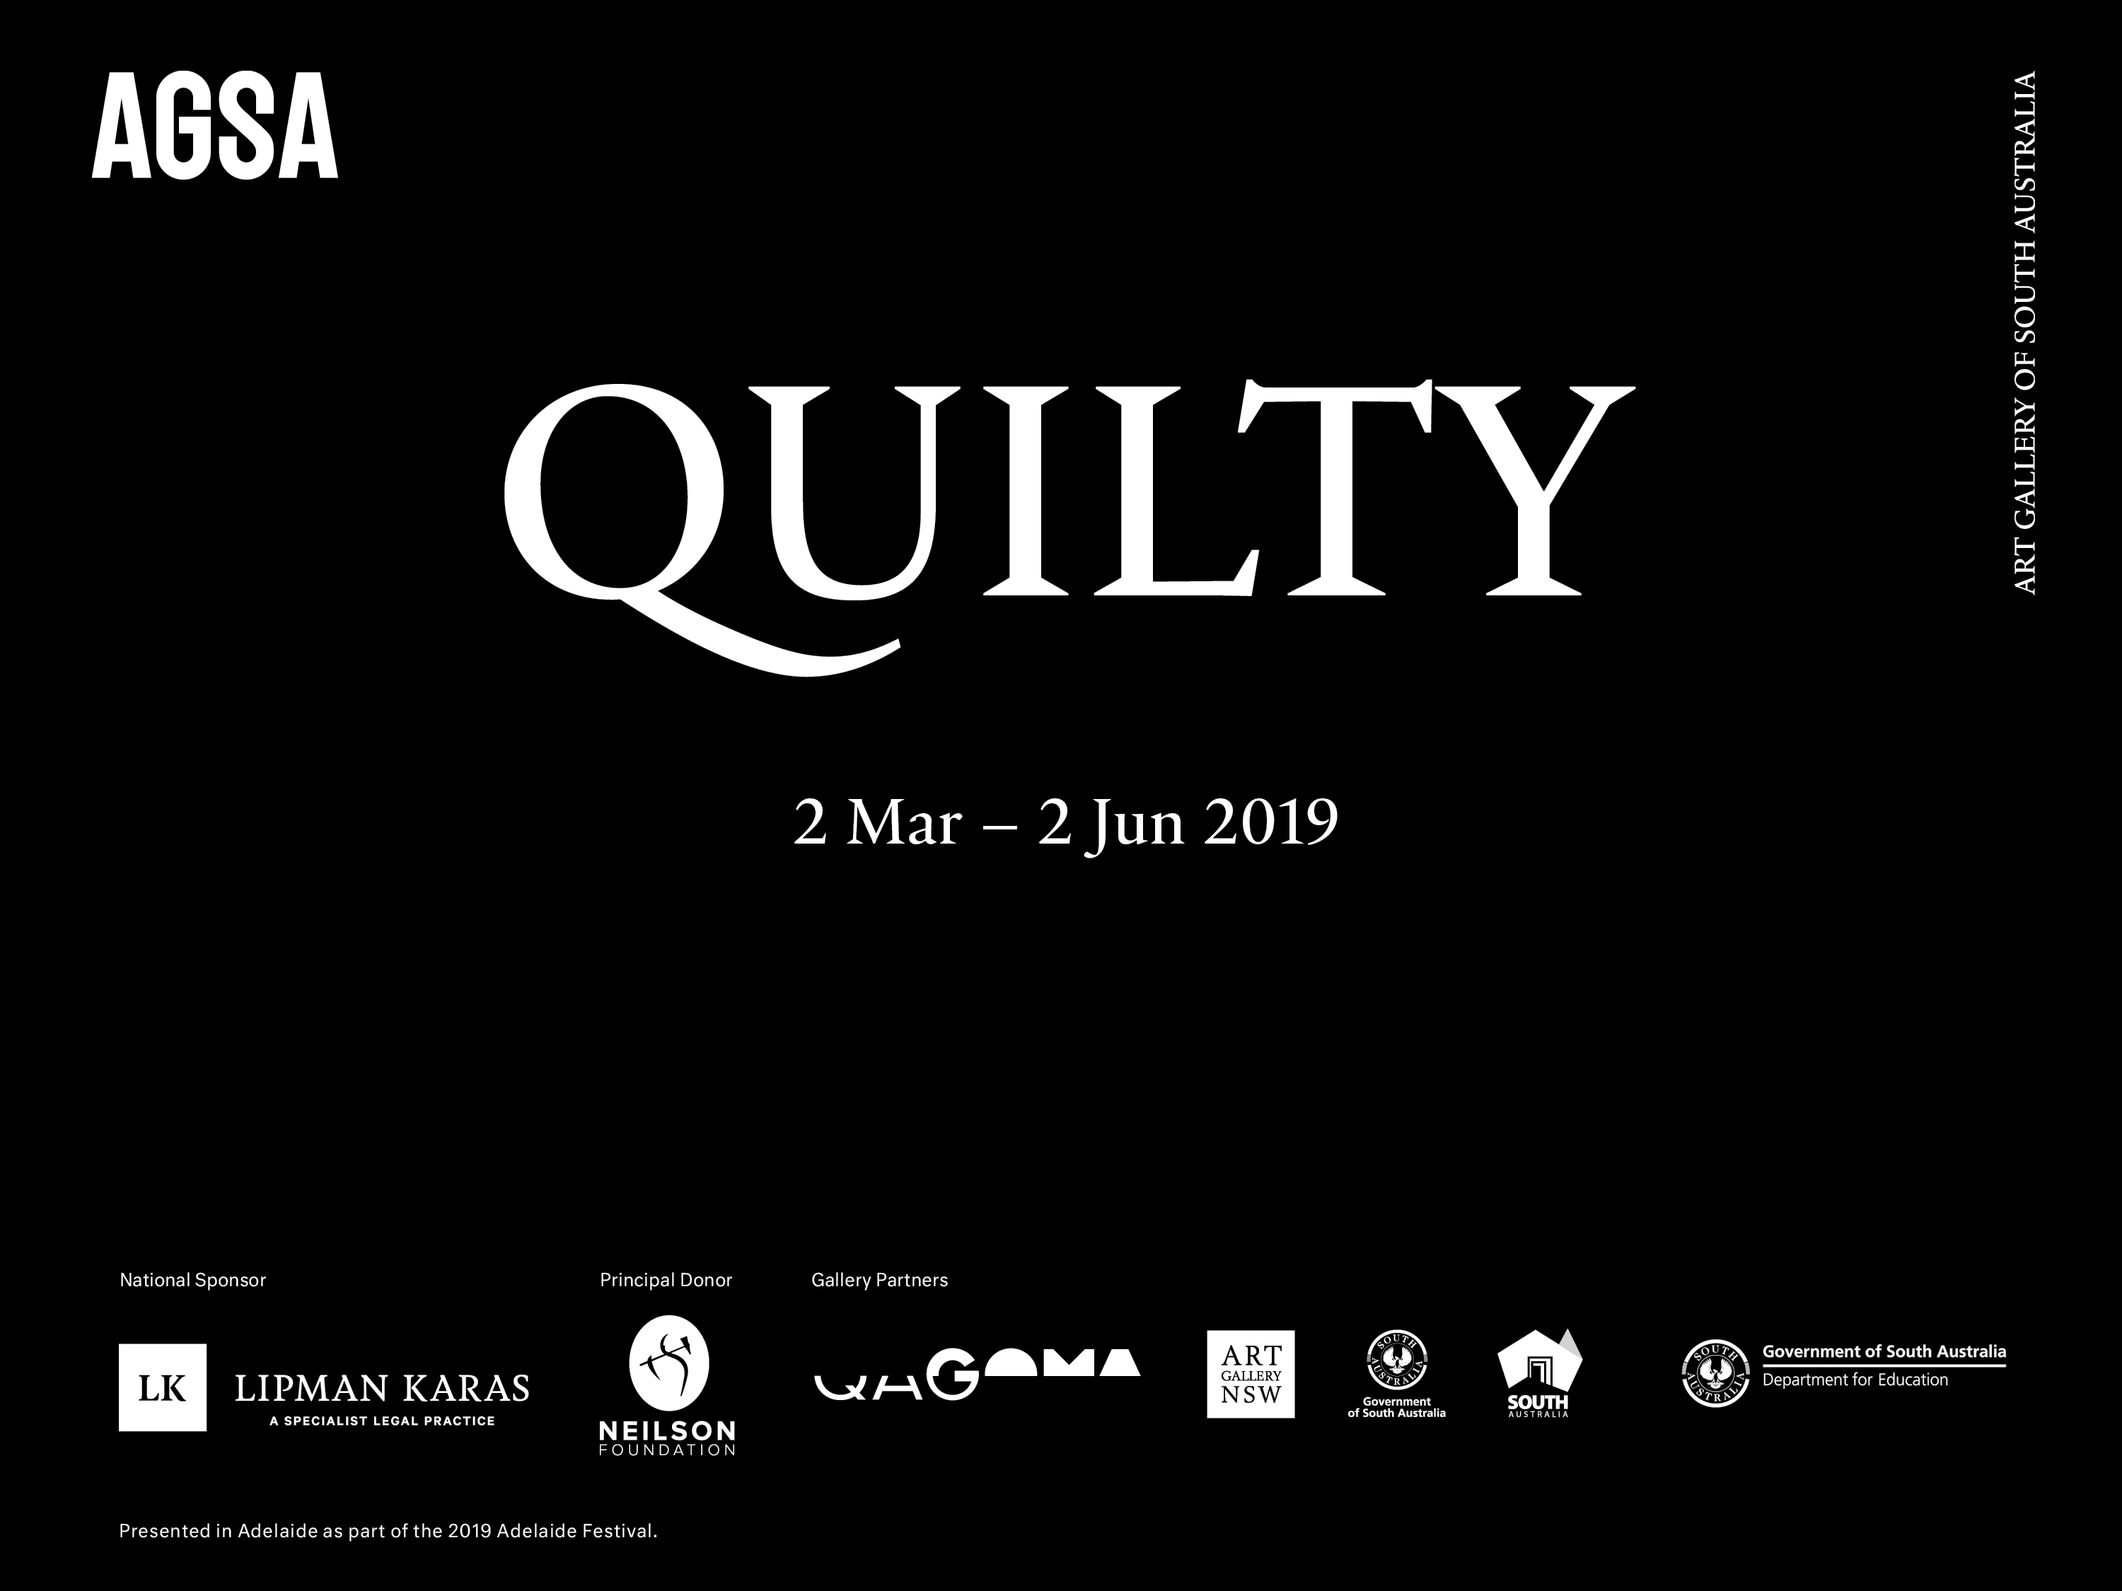
Secondary

Slide 2
Observer Personal and psychological experience
Artist as..
Notes:
Artist as Observer examines how Ben Quilty uses personal and psychological experiences as inspiration for his paintings.

Slide 3
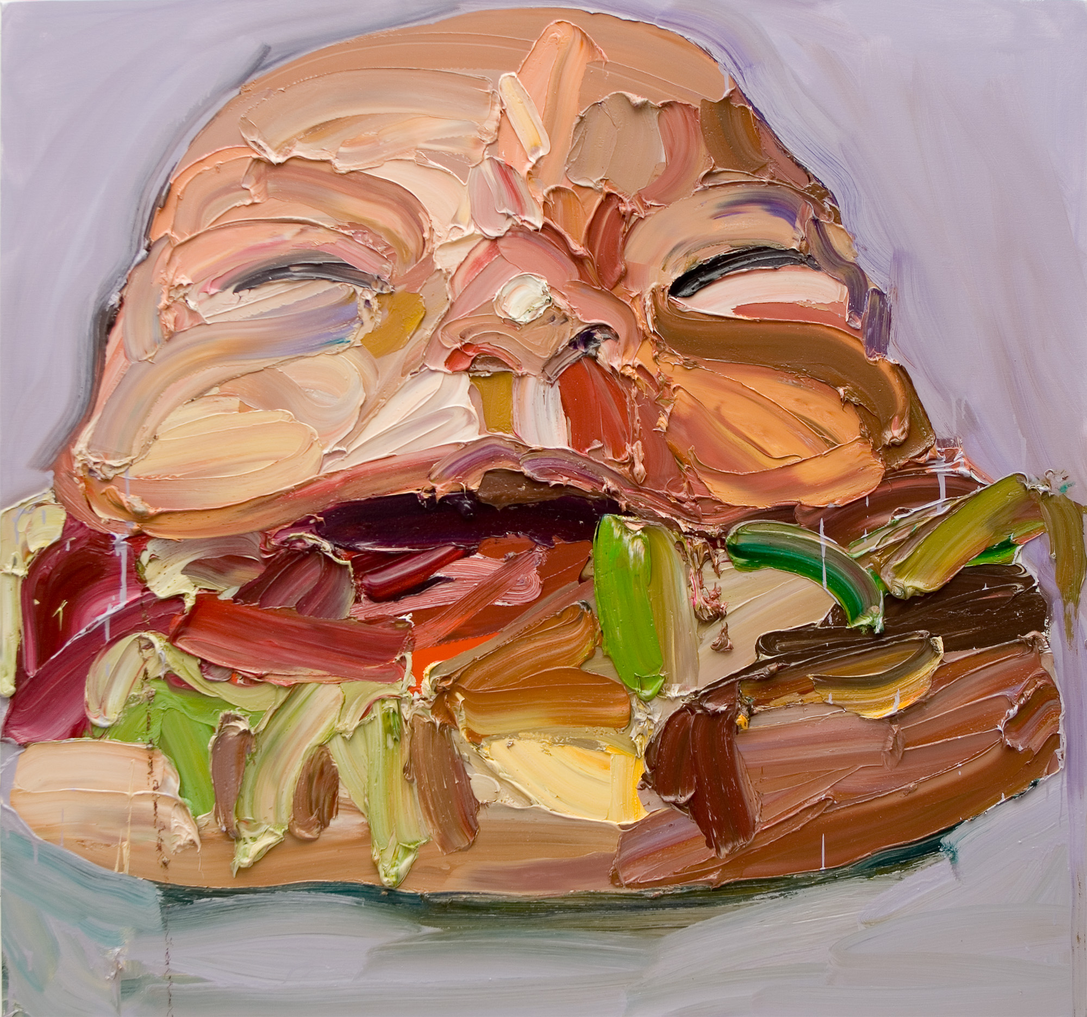
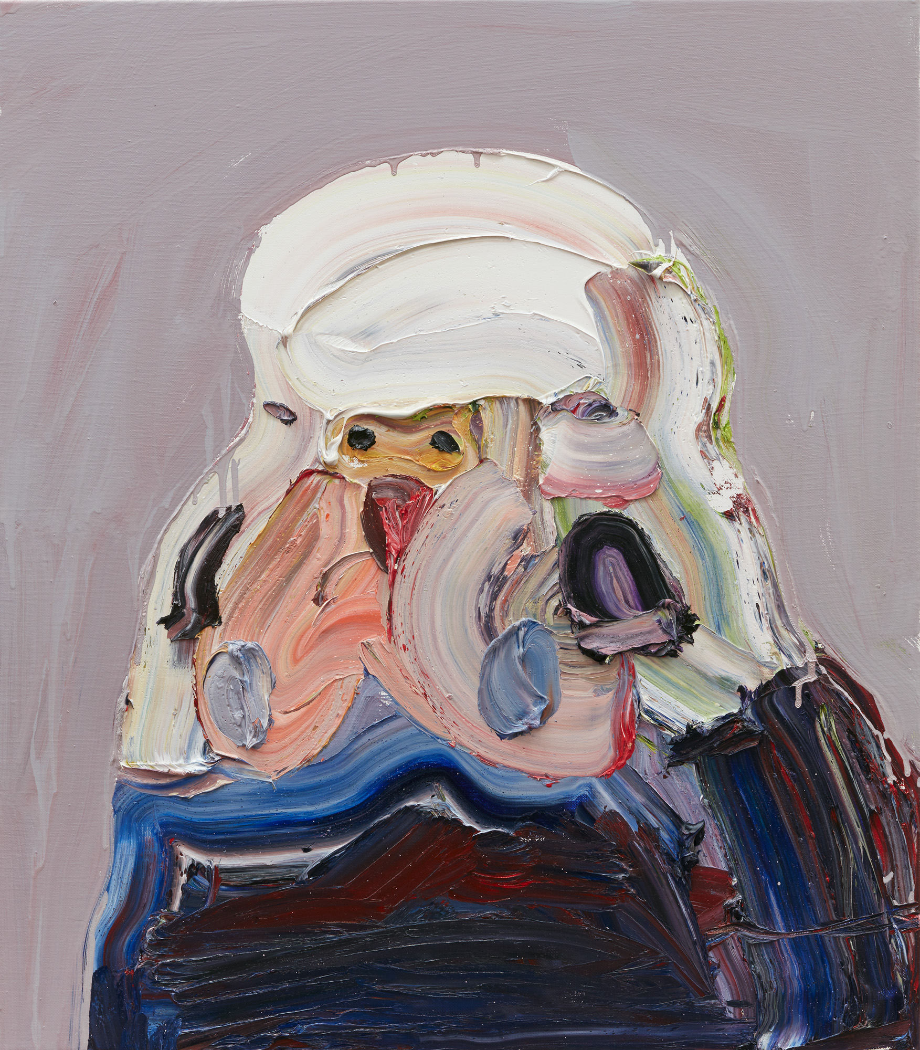
Ben Quilty, Australia, born 1973, Joe Burger, 2006, Southern Highlands, New South Wales, oil on canvas, 150.0 x 160.0 cm; Private collection, Courtesy the artist.
Ben Quilty, Australia, born 1973, New Bird, 2017, Southern Highlands, New South Wales, oil on linen, 80.0 x 70.0 cm; Private collection, Courtesy the artist, photo: Mim Stirling.
Notes:
Responding
What characteristics of Auerbach’s paintings do you think Quilty was influenced by?
Making
Quilty was influenced by a quote by Australian painter, Arthur Streeton (1867-1943) who encouraged fellow artists to look to their own backyard for inspiration. Quilty did just this, painting Torana cars in his backyard. Create a painting that takes inspiration from objects in your own backyard.
Create a painting that captures a memorable moment in your life.
‘Quilty works from life. He has painted birds, cars, his friends and his family. His son Joe has been the subject of his father’s work. As a squalling newborn, Joe’s cry is rendered in paint so loud you need ear muffs. Painted as a hamburger, Joe – aka Joe-burger – collapses the experience of being a parent with popular culture’
– Dr. Lisa Slade, Painting with Purpose, InDaily, February 2019
German born British painter Frank Auerbach is one of Quilty’s heroes. ‘Auerbach was using paint obsessively and by painting his local environment so tirelessly he quietly claimed back paint as a viable medium of communication in the new digital era. Auerbach is one of my heroes’.
– Art Gallery of New South Wales, The art that made me: Ben Quilty.

Slide 4
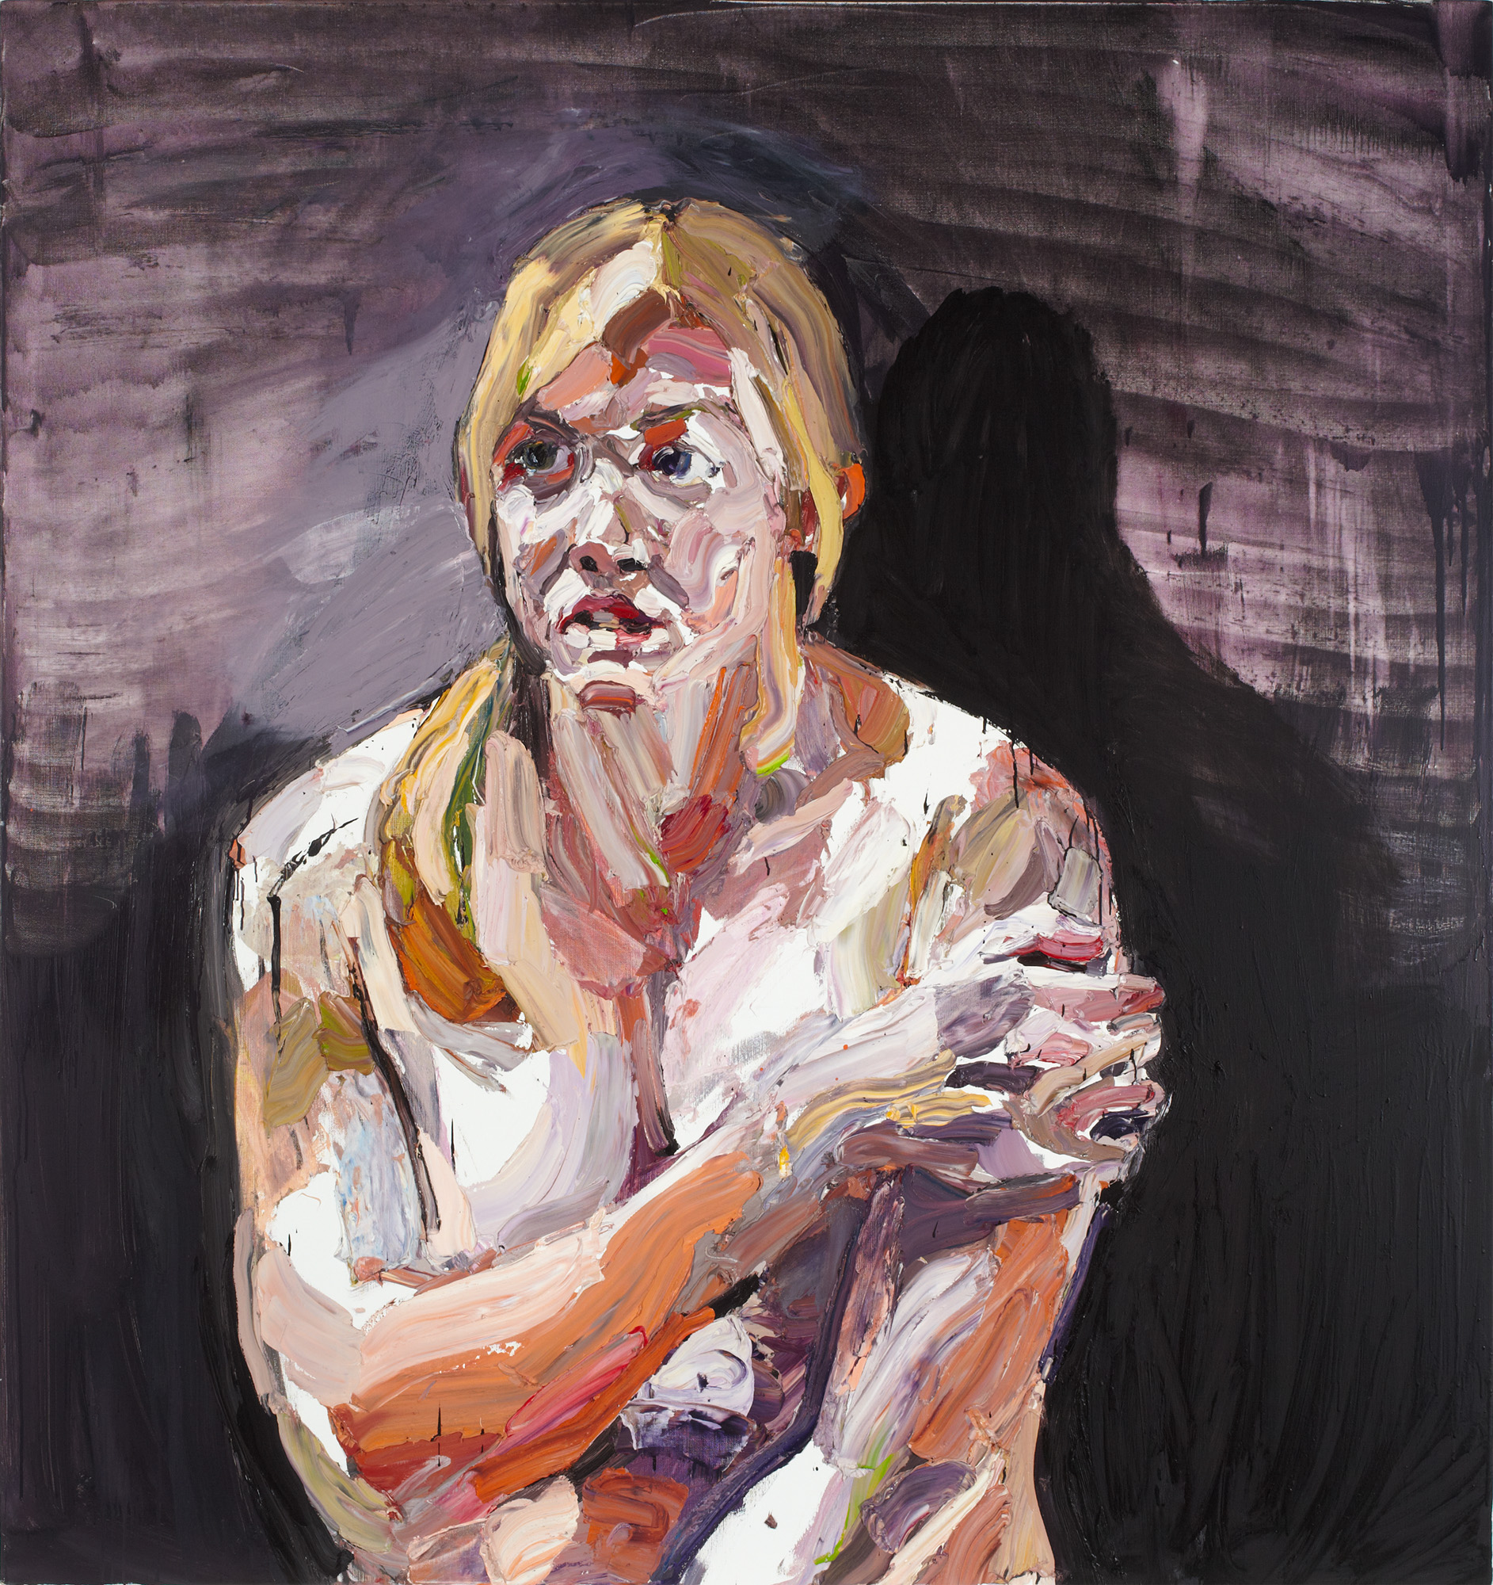
Ben Quilty, Australia, born 1973, Captain Kate Porter, After Afghanistan, 2012, Southern Highlands, New South Wales, oil on linen, 180.0 x 170.0 cm; Donated through the Australian Government's Cultural Gifts Program Collection of Queensland Art Gallery / Gallery of Modern Art, Courtesy the artist, Mim Stirling.
Notes:
After Afghanistan is a series of 21 highly charged portraits and landscapes. These works depict the state of mind of the soldier and the emotional damage caused by war. After his consignment Quilty invited soldiers to his studio in Australia to have their portrait painted while they spoke of their experiences. From these stories Quilty learnt that many soldiers were suffering from PTSD as a result of serving in Afghanistan, a reality of war that has remained largely untouched by commissioned war artists.
Responding
How has Quilty captured the aftermath of these soldiers’ experiences? Compare these portraits to those of soldiers from World War II. How do these depictions differ? Tip: Look at works by Stella Bowen, Ivor Hele, Nora Heysen and H. Septimus Power.
‘Quilty is an advocate for art’s role as a channel for compassion’. Use works of art by Quilty to argue that art is a channel for compassion.

Slide 5
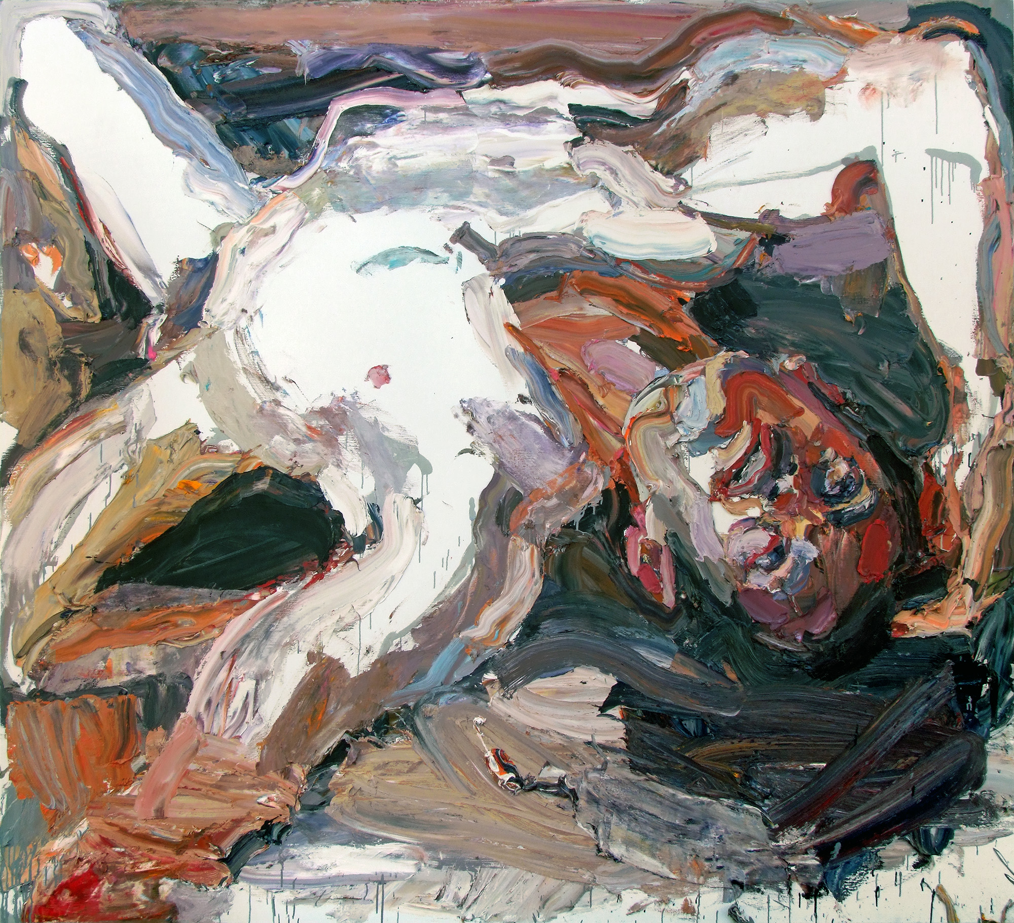
Ben Quilty, Australia, born 1973, Captain S, after Afghanistan, 2012, Southern Highlands, New South Wales, oil on linen, 210.0 x 230.0 cm; Private Collection, Courtesy the artist
Notes:
Responding
Official war artists are commissioned by the Australian War Memorial and play a significant role in Australia’s interpretation of wartime history. Investigate Australian war artists who have been commissioned under this scheme since the First World War to today. How has their role and style changed over time?
Considering the digital world in which we live, does the Australian War Memorial need to continue to engage with artists? Divide the class and conduct a debate with the topic ‘The Australian War Memorial needs to continue funding for official war artists’. Use a variety of artists to support your arguments for and against.
Discuss the following statement: ‘Artists have the power to portray the chaos, calamity and reality of war’. Use works of art by Quilty and German artist Otto Dix to support your argument.
Examine the work of British artists Lucian Freud and Francis Bacon. Compare their works to portraits by Quilty. Discuss how all three artists communicate powerful emotions in the creation of psychological portraits.

Slide 6
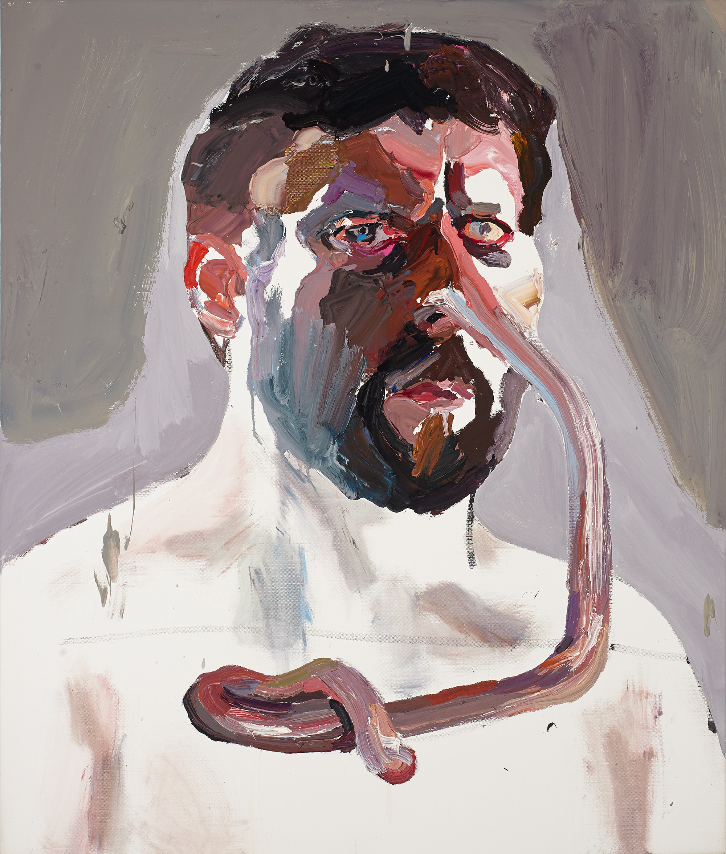
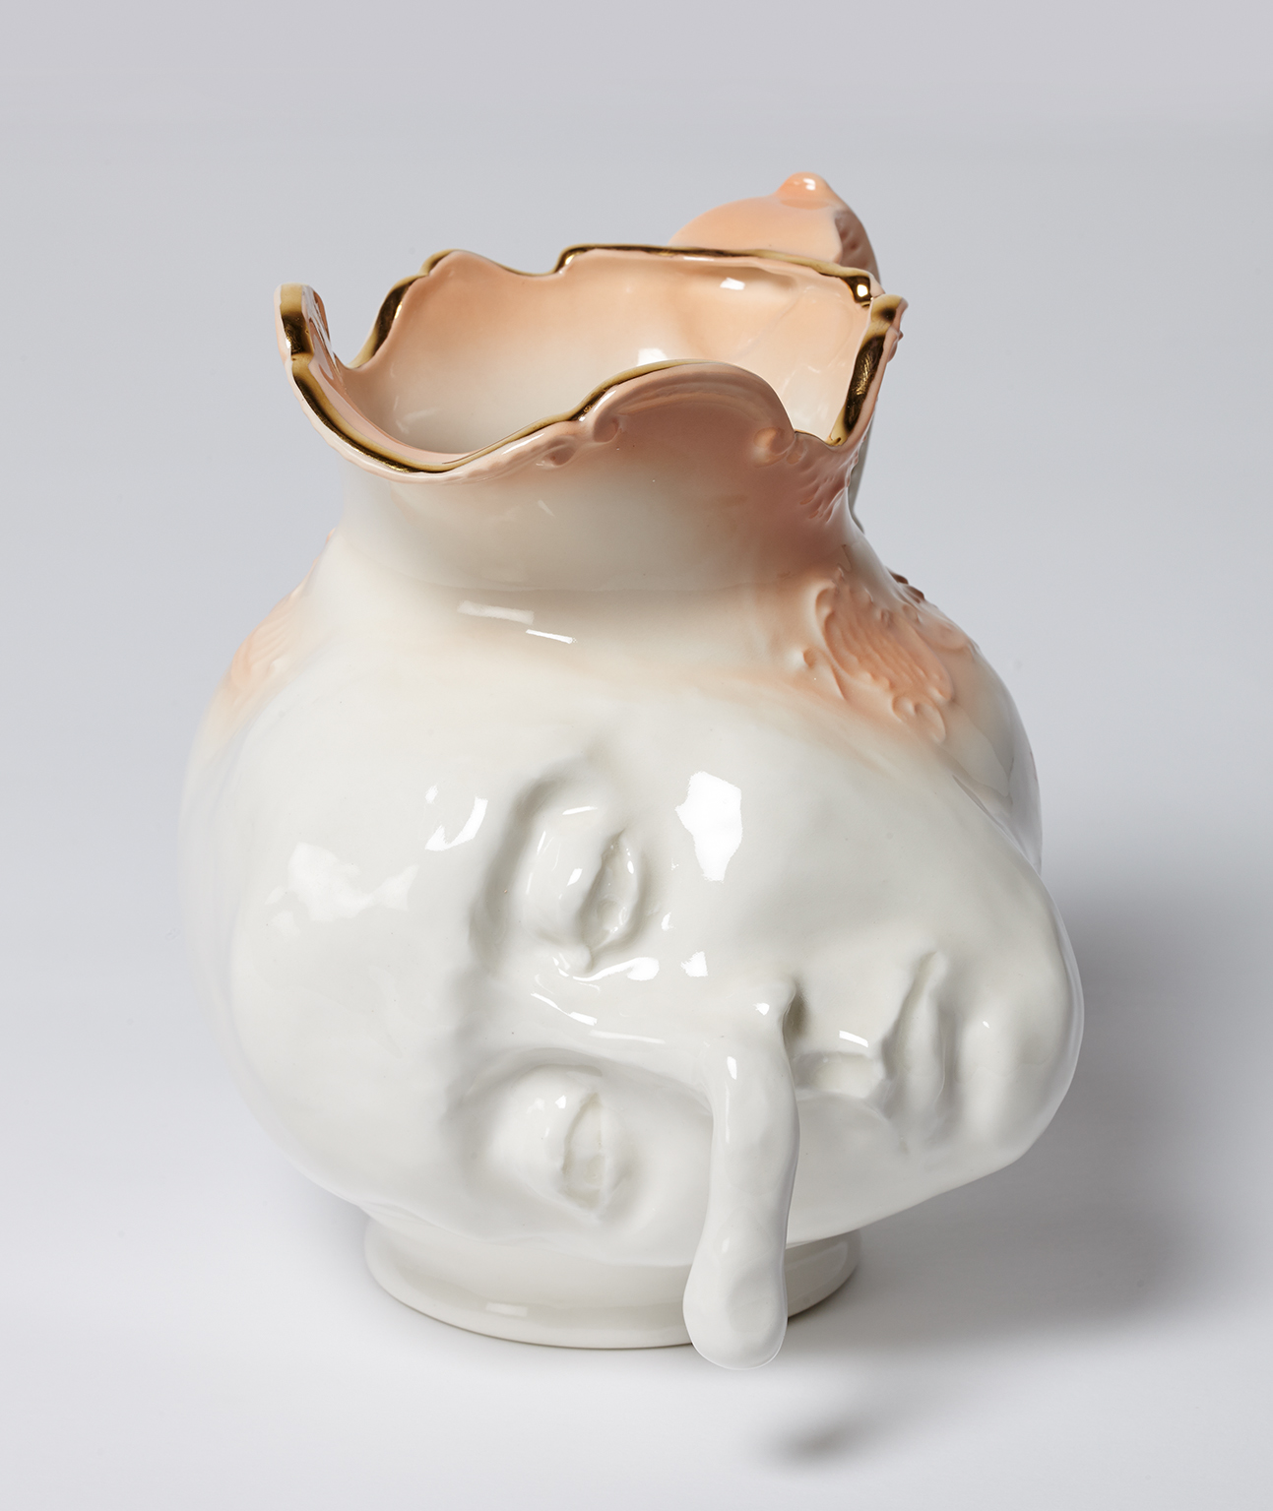
Ben Quilty, Australia, born 1973, Straight white male, nose self-portrait, 2014, Southern Highlands, New South Wales, oil on canvas, 130.0 x 110.0 cm; Private collection, Courtesy the artist.
Ben Quilty, Australia, born 1973, Jug (Nose), 2014, Southern Highlands, New South Wales, porcelain, 23.0 x 23.0 x 23.0 cm; Private collection, Courtesy the artist
Notes:
Making In 2014, Quilty created a number of portraits of his family and friends with exaggerated or elongated features. Quilty asked his children Joe and Olivia to direct these distortions; their choices, he stated, were ‘as good as anyone’s when trying to describe the insanity of contemporary humansʼ. Create a distorted portrait of a family member. Write each feature on separate pieces of paper, select one feature at random and modify your portrait accordingly.
Although Quilty is best known for his work with paint, he has also created three-dimensional works of art. In 2014, Quilty created a series of porcelain forms portraying misshapen faces, some with distressed expressions. These works are based on Toby Jugs or Character Jugs which often depict a well-known person, either as a full figure or the head and shoulders only. Similarly, in 1889 post-impressionist artist, Paul Gauguin (1848-1903) created Jug in the form of a Head, Self-portrait, after the artist had witnessed two traumatic events.
Investigate the history of face jugs. Create a character jug using your own face pulling an exaggerated expression.
‘I often make paintings with the idea that I’m making a sculpture in two-dimensional form’ Ben Quilty - The Evolution of Ben Quilty, Broadsheet, January 2015.

Slide 7
Delinquent vs Activist Cultural and social meaning
Artist as..
Notes:
Artist as Delinquent vs Activist looks at the influence of culture and society, including Quilty’s concerns with the environment and the world around him.

Slide 8
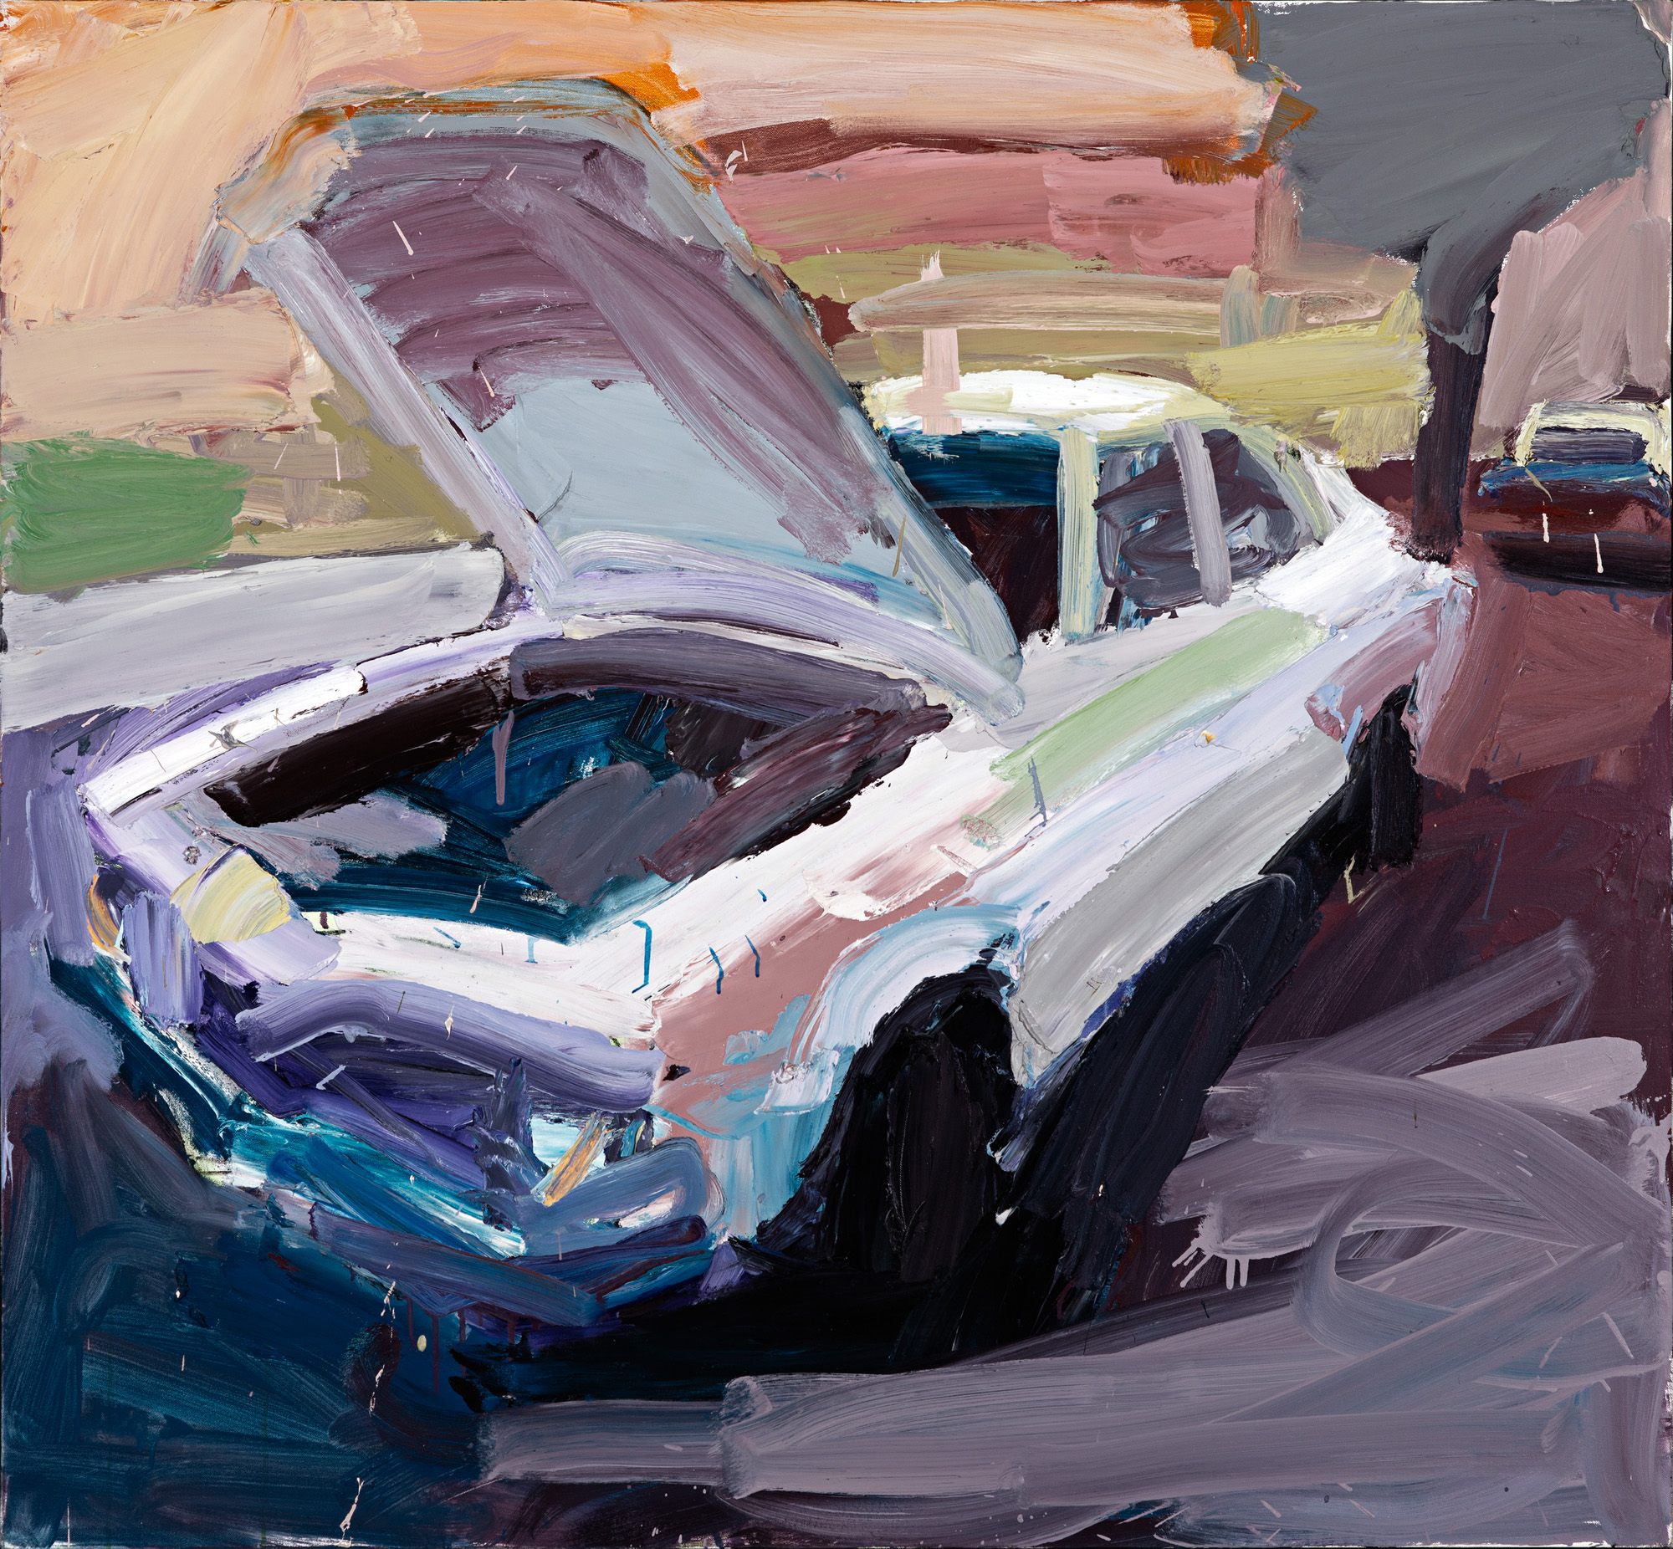
Ben Quilty, Australia, born 1973, Torana no. 5, 2003, Melbourne, oil on canvas, 120.0 x 130.0 cm; Private collection, Courtesy the artist, photo: Philip Betts.
Notes:
Responding Quilty’s earlier paintings of his friends and cars were in response to young male risk-taking and masculinity. Quilty’s 2009 series Crash and Burn depicts a series of 1970s muscle cars dramatically crashed and burnt out against a stark white canvas. Literary critic Germaine Greer stated ‘they depict the self-destructive urges that lie at the heart of many young men’.
It has been more than ten years since Quilty made these works. How has risk-taking changed in that time? Do you think the risks taken by young people today are more/less dangerous? What makes you think so? What factors now influence risk taking behaviours that didn’t exist ten years ago?

Slide 9
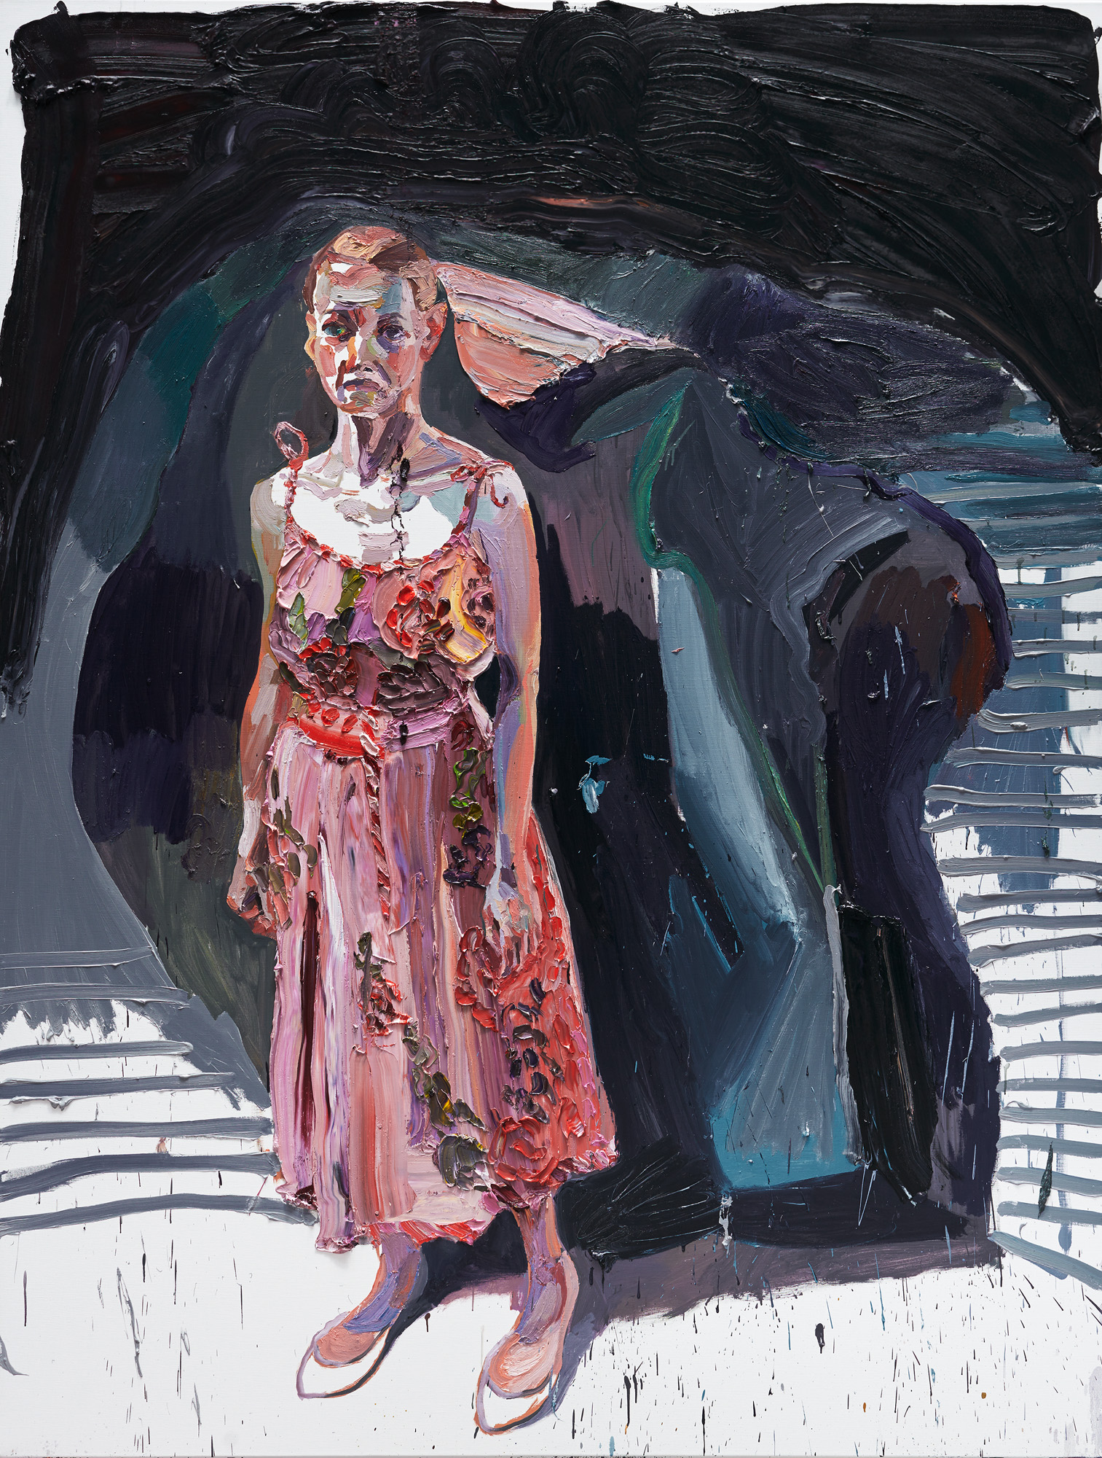
Ben Quilty, Australia, born 1973, The Pink dress, 2016, Southern Highlands, New South Wales, oil on linen, 265.0 x 202.0 cm; Private Collection, Courtesy the artist, photo: Mim Stirling.
Notes:
Responding
How has Quilty created the dark or seemingly black areas of his paintings? Look closely, what colours are they? Locate other works of art in the collection where an artist has used pigments other than black to create shadows. Did you know?
The Impressionists were inspired by the theory of complementary colours and were convinced that no shadow was actually black. Instead, the Impressionists painted shadows in dark shades of violet, in contrast to its complementary sunlight (yellow), resulting in bright and vivid scenes.
‘No student should ever use black, black doesn’t exist’ – Ben Quilty, NGA, 2019.

Slide 10
‘It is hard to empathise with a person if there is no sense of that person’s humanity … I want people in my country to know what is happening’.
Ben Quilty, A Memorial in Paint, Articulate, Spring 2018

Slide 11
Ben Quilty, Australia,
born Sydney 1973
all works: oil on linen 130 x 110 cm
top row: Reza, 2016; Gift of Paul Walker and Patricia Mason in memory of Reza Omid Masoumali, 2016; Gift of Paul Walker and Patricia Mason in memory of Omid Masoumali Omid Ali Avaz, 2016; Gift of Paul Walker and Patricia Mason in memory of Omid Ali Avaz
second row: Ali Jaffari, 2017; Gift of Paul Walker and Patricia Mason in memory of Ali Jaffari Mohammad Nazari, 2017; Gift of Paul Walker and Patricia Mason in memory of Mohammad Nazari Khodayar Amini, 2017; Gift of Paul Walker and Patricia Mason in memory of Khodayar Amini
third row: Fazel Chegeni, 2017; Gift of Paul Walker and Patricia Mason in memory of Fazel Chegeni Leo Seemanpillai, 2017; Gift of Paul Walker and Patricia Mason in memory of Leo Seemanpillai Rezene Mebrahta Engeda, 2017; Gift of Paul Walker and Patricia Mason in memory of Rezene Mebrahta Engeda
fourth row: Fereshteh, 2016; Gift of Paul Walker and Patricia Mason in memory of Fereshteh Rakib, 2016; Gift of Paul Walker and Patricia Mason in memory of Rakib Mohammad Hadi, 2016; Gift of Paul Walker and Patricia Mason in memory
of Mohammad Hadi all works: through the Art Gallery of South Australia Contemporary Collectors 2018. Donated through the Australian Government’s Cultural Gift Program
© Ben Quilty
Notes:
About the work
‘Created in 2016 and 2017, this group of 12 paintings of empty orange life-jackets is dedicated to the lost lives of asylum seekers who committed suicide whilst held in detention. Each vest records the name of the individual, hopeful for a better life, who sought refuge in Australia, but, frustrated and hopeless, took their own life before being granted sanctuary. Mohammad Nazari, a 35 year old Hazara man overcome by events in his past and the uncertainty of bridging visa, hanged himself while in Sydney. Khodayar Amini set fire to himself when he believed he would be returned to Afghanistan and certain death. All were traumatised refugees, who were never given refuge. Quilty captures their flight and honours each life in paint, the orange jacket suspended in an empty void rendered aggressively in thick, violent brushstrokes. Fearful eyes or crying mouths appear on several vests, desperate and imploring’.
– Leigh Robb, Curator of Contemporary Art & Dr. Lisa Slade, Assistant Director, Artistic Program AGSA
‘Each life vest is in effect a tombstone, a way of remembering the dead. Together the paintings constitute a memorial, as lugubrious and dour an epitaph as Australia’s refugee policy’. – Michael Desmond, catalogue essay for The Stain, Tolarno Gallery, 2016

Slide 12
‘there are things we need to stand up for and speak out about. I believe that as an artist, that’s my job’.
Ben Quilty on ‘When Silence Falls’, 2016
Notes:
Responding
As a class brainstorm the role of the artist. Discuss what an activist is. Do some of these descriptions overlap? Consider how the role of artists in Australia has changed. What responsibilities do artists have now that they didn’t have 200 years ago?
‘If my art has nothing to do with people’s pain and sorrow, what is art for?’
- Chinese artist and activist Ai Weiwei

Slide 13
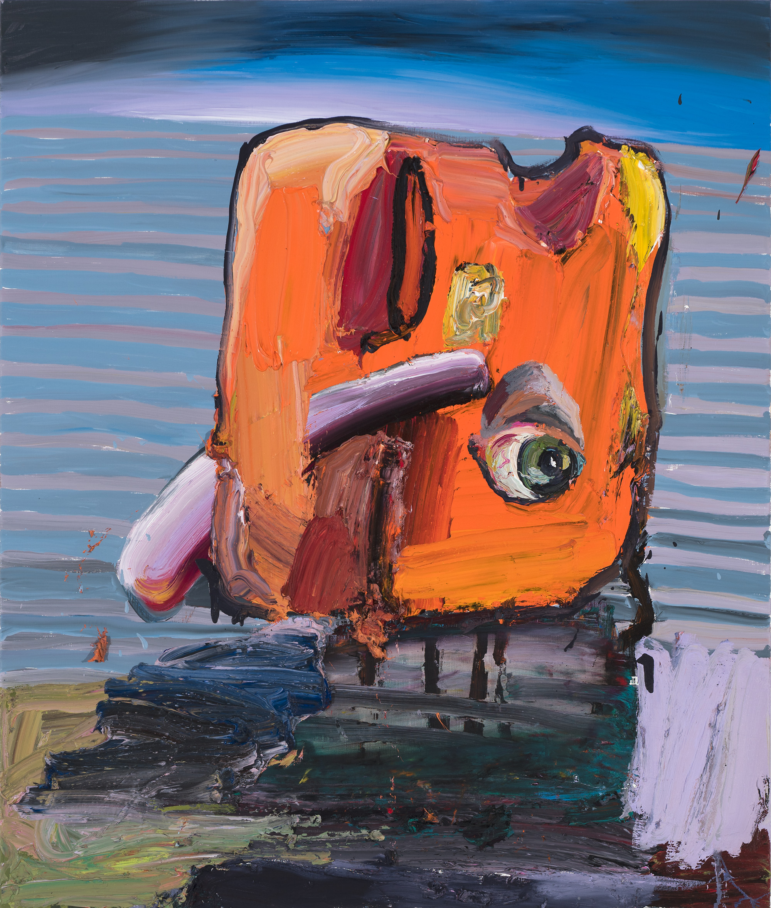
Ben Quilty, Australia, born 1973, Fereshteh, 2016, Southern Highlands, New South Wales, oil on linen, 130.0 x 110.0 cm; Gift of Paul Walker and Patricia Mason in memory of Fereshteh through the Art Gallery of South Australia Contemporary Collectors 2018. Donated through the Australian Government’s Cultural Gift Program, Art Gallery of South Australia, Adelaide, Courtesy the artist, photo: Brenton McGeachie.
Ben Quilty, Australia, born 1973, Omid Ali Avaz, 2016, Southern Highlands, New South Wales, oil on linen, 130.0 x 110.0 cm; Gift of Paul Walker and Patricia Mason in memory of Omid Ali Avaz through the Art Gallery of South Australia Contemporary Collectors 2018. Donated through the Australian Government’s Cultural Gift Program, Art Gallery of South Australia, Adelaide, Courtesy the artist, photo: Brenton McGeachie.
Ben Quilty, Australia, born 1973, Mohammad Hadi, 2016, Southern Highlands, New South Wales, oil on linen, 130.0 x 110.0 cm; Gift of Paul Walker and Patricia Mason in memory of Mohammad Hadi through the Art Gallery of South Australia Contemporary Collectors 2018. Donated through the Australian Government’s Cultural Gift Program, Art Gallery of South Australia, Adelaide, Courtesy the artist, photo: Brenton McGeachie.
Notes:
Responding
In 2016 Ben Quilty travelled to Europe and the Middle East with writer Richard Flanagan, where they witnessed first-hand the refugee crisis. Quilty and Flanagan met families who had lost family members including children who had attempted the journey across the Aegean Sea. The life jacket, known for its ability to save lives has been used by Quilty in many ways to draw attention to the lives lost of those seeking refuge.
Listen to the SoundCloud talk with Richard Flanagan and Ben Quilty.
Research works of art by Alex Seton and Ai Weiwei. Both of these artists have incorporated life jackets into their work. How does their use of this symbol compare to Quilty?
Read ‘Home’ curated by Ben Quilty with Forward by Richard Flanagan and Notes on Exodus by Richard Flanagan. Describe these texts in one word.
Compose a creative piece of writing titled ‘Artist as activist’, which pays tribute to the work of Flanagan and Quilty.
Art is often a comment on humanity. When learning about art history, we tend to look back 100 years or more to help us understand what life was like and how we have evolved. Imagine it is 100 years from now. What are some of the overarching messages Flanagan and Quilty are bringing to the fore that future generations can learn?

Slide 14
Communicator Using signs and symbols to communicate meaning
Artist as..
Notes:
Artist as Communicator considers how Quilty uses visual language to communicate meaning.

Slide 15
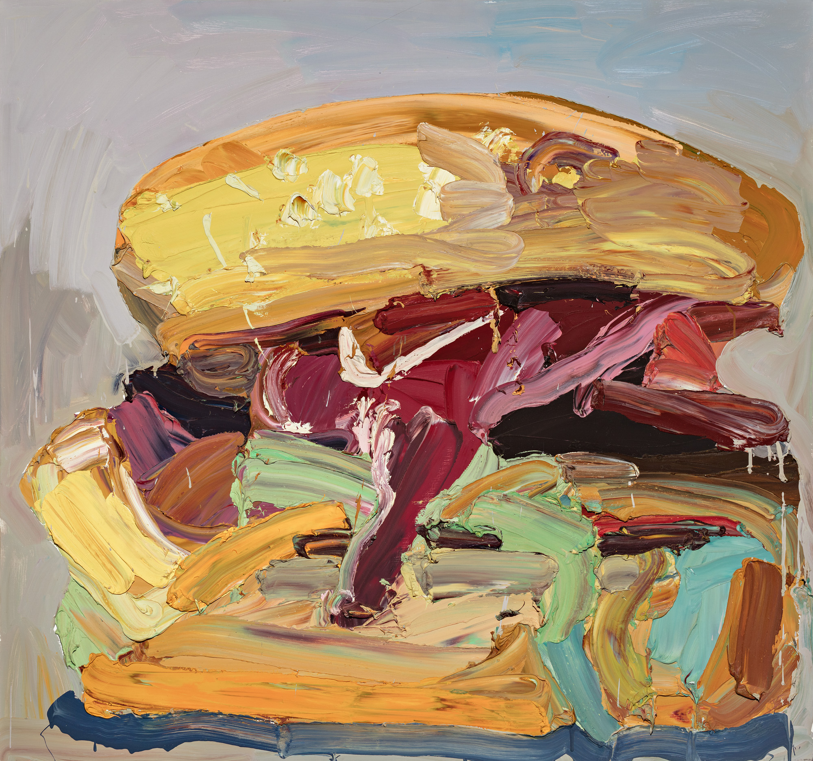
Ben Quilty, Australia, born 1973, The lot, 2006, Bowral, New South Wales, oil on canvas, 150.0 x 160.0 cm; Gift of Ben Quilty through the Art Gallery of South Australia Contemporary Collectors 2016. Donated through the Australian Government's Cultural Gifts Program, Art Gallery of South Australia, Adelaide, Courtesy the artist.
Notes:
About the work
Completed in 2006, The Lot is a work which displays Quilty’s signature gestural style in thick oil paint, applied with speed, confidence and first-hand knowledge of his fast-food subject matter. Quilty’s hamburger, a symbol of popular culture and consumerism is loaded with “the lot”. It is messy, juicy and packed with lashings of colour. Scaled-up, sitting centre-square and much larger than life, in this work Quilty is elevating the humble road-side burger to an iconic status. Quilty painted a number of burgers in 2006, including Skull-burger and Joe-burger, as well as his hallmark series of Holden Torana cars which affectionately but critically reflect on white Australian masculinity through the products of hoon culture and mateship.
Responding
Find a glossary of words used to describe food. Using words from this glossary, write a story or poem that describes Quilty’s paintings.
Making
The Lot is one of several burger paintings created from 2006-2010, exploring the power of pop culture items. They are big and bold, with lurid colours and loose gestural mark-making. The Lot has been described as juicy – how would you describe your favourite food? Create a work of art celebrating your favourite food, which captures the food (larger than life) and the way you describe it.

Slide 16
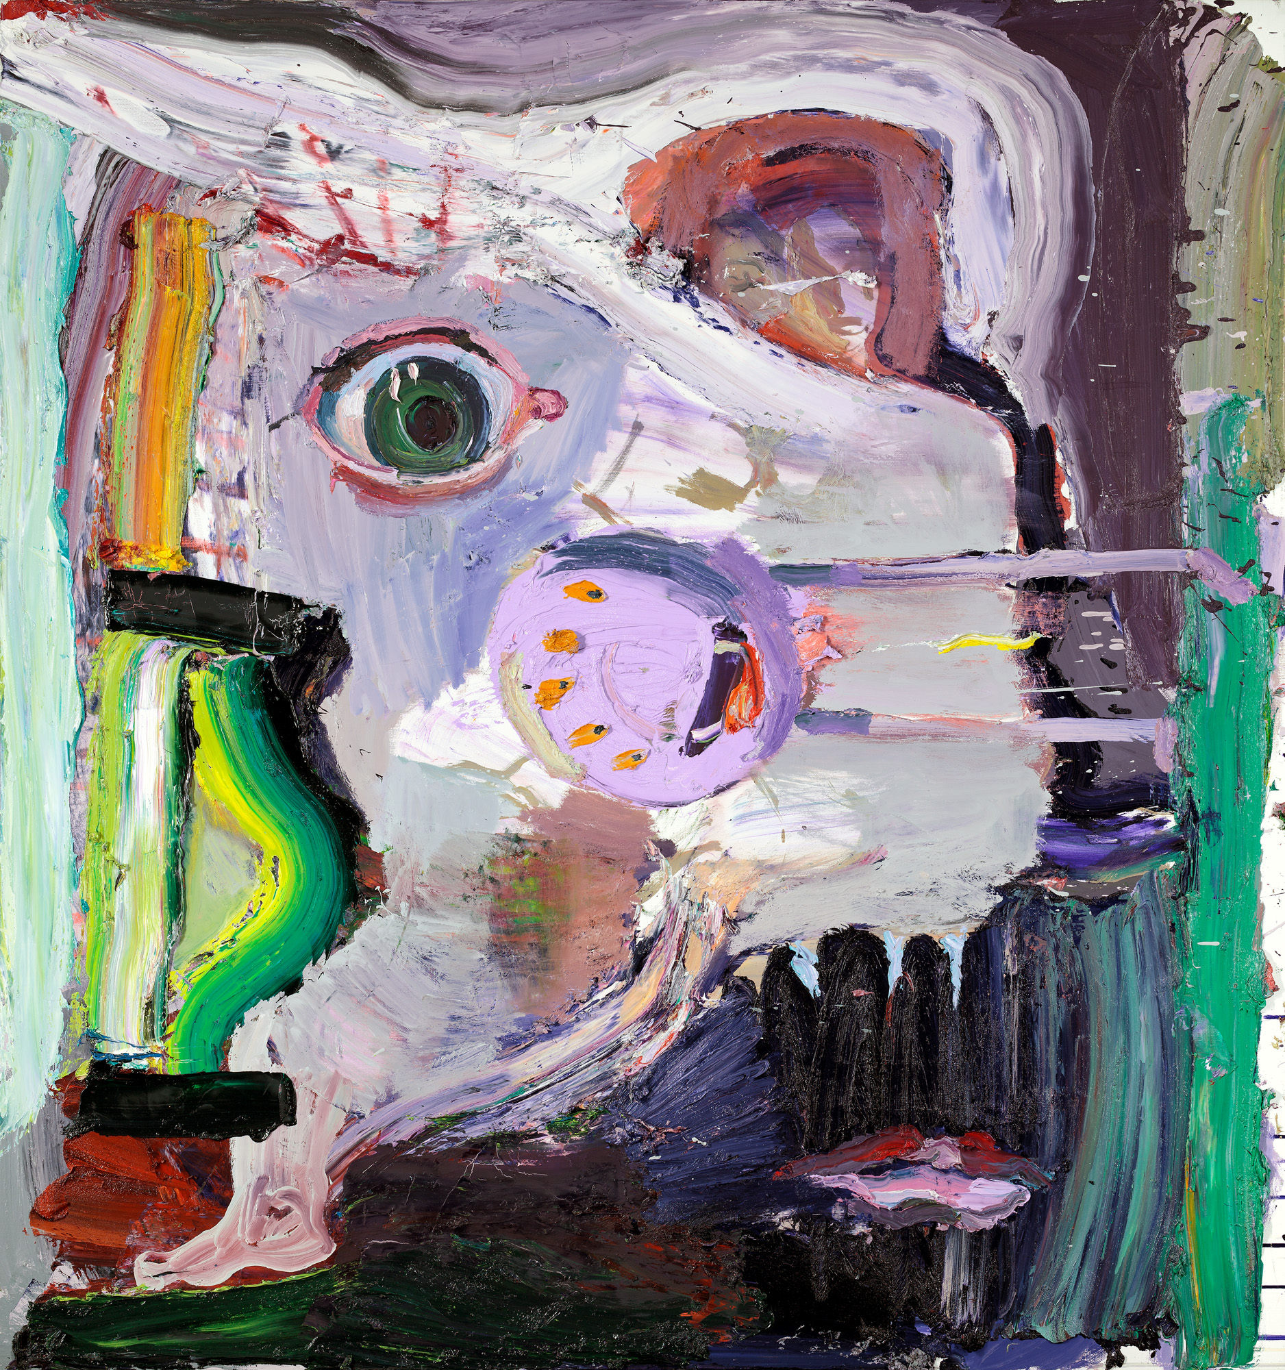
Ben Quilty, Australia, born 1973, The blue pill (explain the world), 2016, Southern Highlands, New South Wales, oil on linen, 183.0 x 173.0 cm (overall); Private Collection, Courtesy the artist.
Notes:
‘Purple, or rather lilac, is Ben Quilty’s favourite colour. The colour of grief – purple and its familiars – works its way time and again into Quiltyʼs paintings. For thousands of years, long before synthetic paints, purple was tinted with sorrow and destruction’. – Dr. Lisa Slade, Quilty, Penguin Books, 2019, p. 27
Responding The imperial purple favoured in antiquity by the affluent and influential required the killing of a quarter of a million murex shellfish to produce a mere ounce of dye – it was described as the tears of the sea snail. Investigate the history of pigments. What surprising or unusual stories can you discover? Write a narrative poem about the life of your favourite colour.

Slide 17
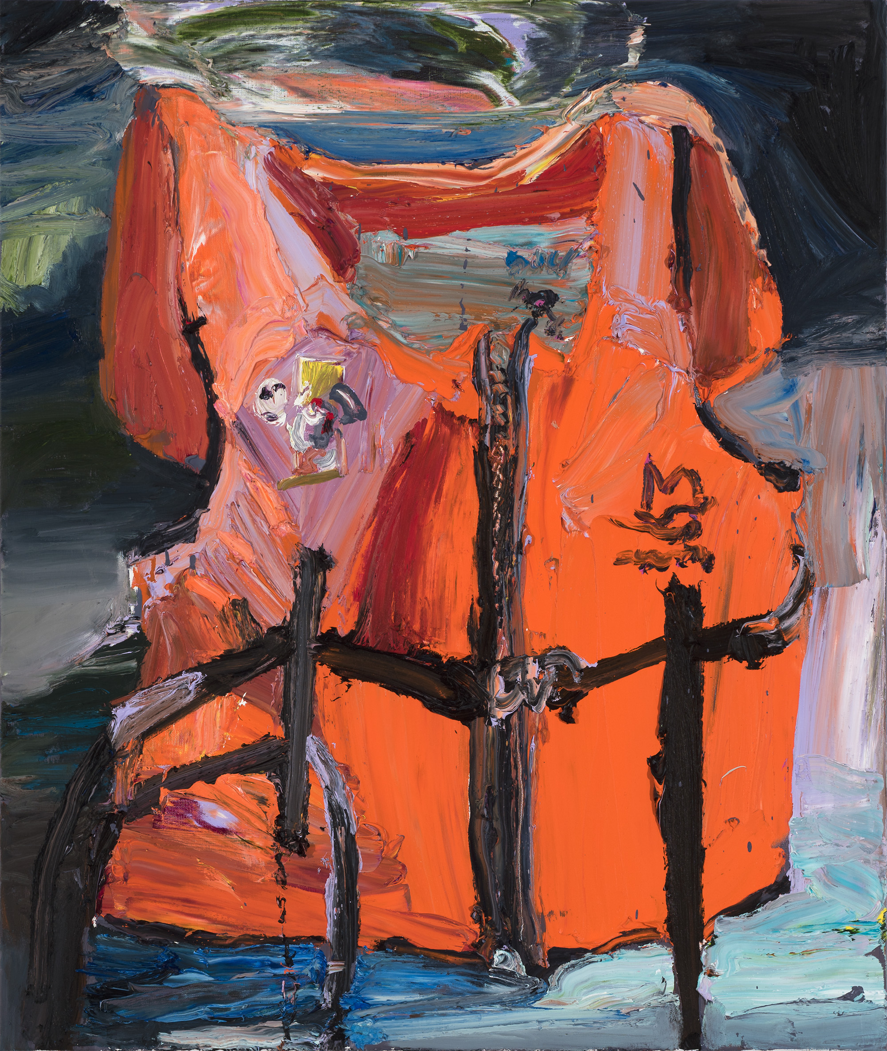
Ben Quilty, Australia, born 1973, Ali Jaffari, 2017, Southern Highlands, New South Wales, oil on linen, 130.0 x 110.0 cm; Gift of Paul Walker and Patricia Mason in memory of Ali Jaffari through the Art Gallery of South Australia Contemporary Collectors 2018. Donated through the Australian Government’s Cultural Gift Program, Art Gallery of South Australia, Adelaide, Courtesy the artist, photo: Brenton McGeachie.
Ben Quilty, Australia, born 1973, Torana no. 5, 2003, Melbourne, oil on canvas, 120.0x 130.0 cm; Private collection, Courtesy the artist, photo: Philip Betts.
Notes:
‘Quilty’s paintings from life remind us that death is never far from our door. Still life paintings have always performed this role. As memento mori, or ‘reminders of death’, still lifes urge the onlooker to seize the day, to live life and to live it well’.
– Dr. Lisa Slade, Painting with Purpose, InDaily, February 2019.
Responding
Discover other still life paintings on display in the Gallery and research Vanitas still life symbolism. Using Quilty’s paintings of life vests and Toranas, discuss how still life painting has evolved throughout art history.

Slide 18
Ben Quilty, Australia, born 1973, Skull landscape, 2006, oil and aerosol on linen, 160.0 x 170.0 cm; Private Collection, Courtesy the artist
Notes:
Responding
Investigate artists who have depicted skulls in their work. Compare their use of skulls to the skulls in Quilty’s paintings.
Tip: Look at Peter Claesz, Lidia Groblicka and Ricky Swallow.

Slide 19
Ben Quilty, Australia, born 1973, Self-portrait after Afghanistan, 2012, Southern Highlands, New South Wales, oil on linen, 130.0 x 120.0 cm; Private collection, Sydney, Courtesy the artist, photo: Mim Stirling.
Notes:
‘The practice of drawing is a fundamental skill for all other art forms. It is about looking, responding and hand eye coordination. Turn a mirror on yourself. See yourself as a form and an object. You will begin to notice just how weird the human face is – some areas have completely no hair’
– Ben Quilty, NGA, 2019.
Making Look at yourself in a mirror and draw a series of self-portraits using oil or chalk pastels. Cut up your portraits into large random shapes and reconfigure these to make a new remix portrait.

Slide 20
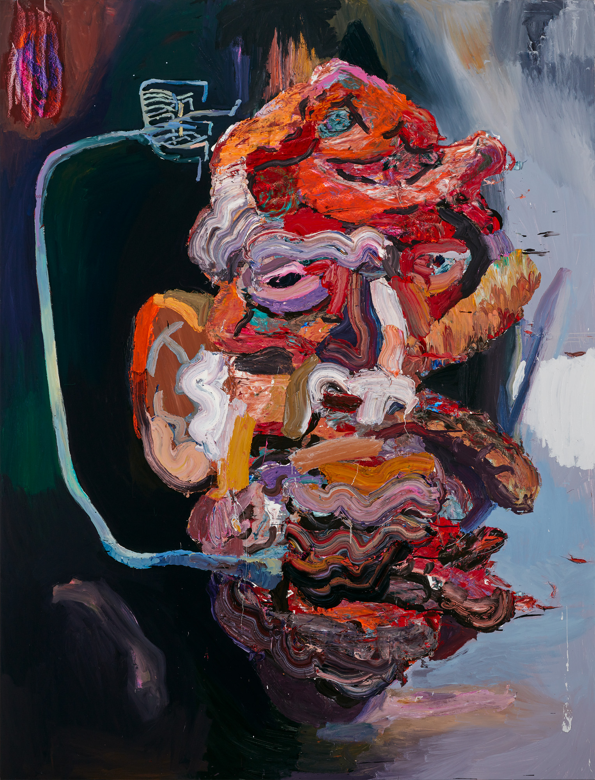
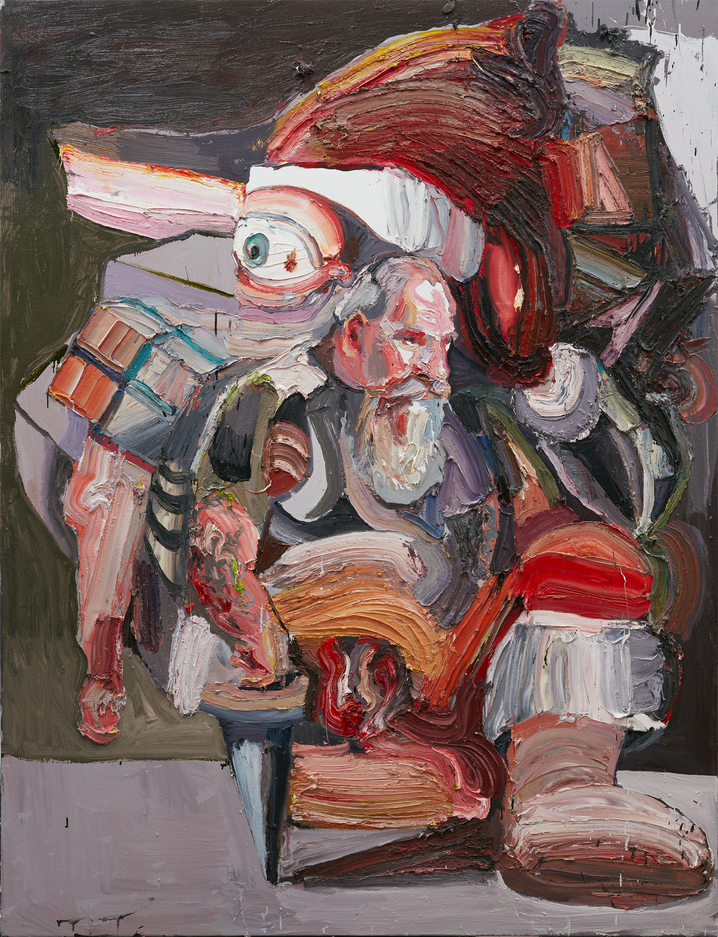
Ben Quilty, Australia, born 1973, The Goldilocks Zone (Banksia Man), 2015, Southern Highlands, New South Wales, oil on polyester, 265.0 x 202.0 cm; Private collection, Adelaide, Courtesy the artist
Ben Quilty, Australia, born 1973, The Last Supper (Bottom Feeder), 2018, Southern Highlands, New South Wales, oil on linen, 265.0 x 202.0 cm; Private Collection, Courtesy the artist
Notes:
Responding What techniques or strategies does Quilty use to lure us towards his paintings?
Quilty uses oil paint sometimes mixed with a medium, making the paint thick and luscious. Research other advancements in science and technology that occurred during the nineteenth and twentieth centuries. Consider how new technologies and materials have transformed the way artists work today.
Some of Quilty’s paintings made in 2017 were described by writer Justin Paton to have a ‘tension between attraction and repulsion’. Find a work of art where you think Quilty has created this tension. Is there a painting you are attracted to, but also find repulsive?
Making Quilty has been known to use cake decorating tools in the application of paint to a surface. Investigate other artists who have used non-traditional tools or methods to create their work. Create a self-portrait using tools only found in a kitchen. Tip: James Dodd and Cameron Robbins.

Slide 21
Revisionist Critical practices which challenge traditional conventions
Artist as..
Notes:
Artist as Revisionist investigates Quilty’s interrogation of Australian history and identity through the reinterpretation of images and painting practices.

Slide 22
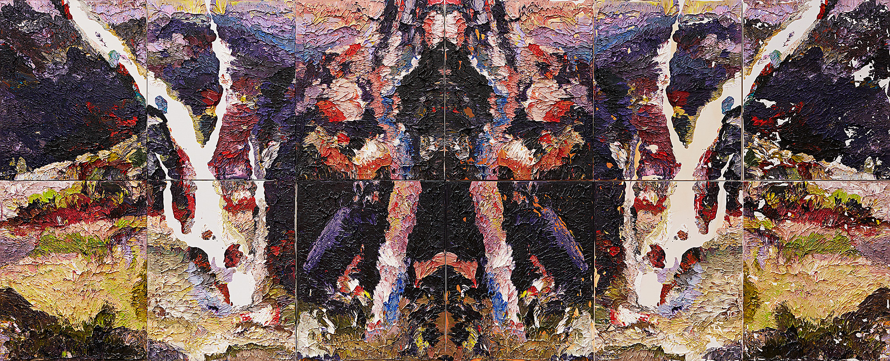
Ben Quilty, Australia, born 1973, Irin Irinji, 2018, Southern Highlands, New South Wales, oil on linen (12 panels), 224.0 x 551.0 cm; Private Collection, Courtesy the artist
Notes:
‘Large Rorschach paintings recur throughout the exhibition. Using a psychoanalytical tool designed to evaluate and extract the dark and unconscious elements of personality and experience, Quilty’s monumental ink blot paintings explores the dark undercurrent of the Australian psyche, one haunted by violence and displacement.
Devised by Herman Rorschach in the early twentieth century as a method of psychological assessment, ‘Rorschacing’ is also referred to as an ink blot test, where an abstract shape is shown to a patient providing insight into their psychology and anxieties. This technique is also one that was prized by Rorschach’s contemporaries, the Surrealists – a version of their much-loved decalcomania, a technique of chance that invited free association and creative delirium. This way of working represents a perilous strategy as a painting technique – Quilty loads the canvas with impasto oil paint, only to destroy the paint surface by pressing a second unpainted canvas directly onto the first. The process – in essence a reprographic one – demands the meticulous control of paint, colour and composition, but it also invites possibility. Chance intervenes in creating accidents and abstractions that invite the viewer to reflect on their own perceptions, desires and experiences’
- Dr. Lisa Slade, Quilty exhibition room guide, 2019.
Making
Using watercolour paint or ink, create a series of irregular blobs or marks on a page. Swap your page with someone else in your class and transform these marks into something recognisable.

Slide 23
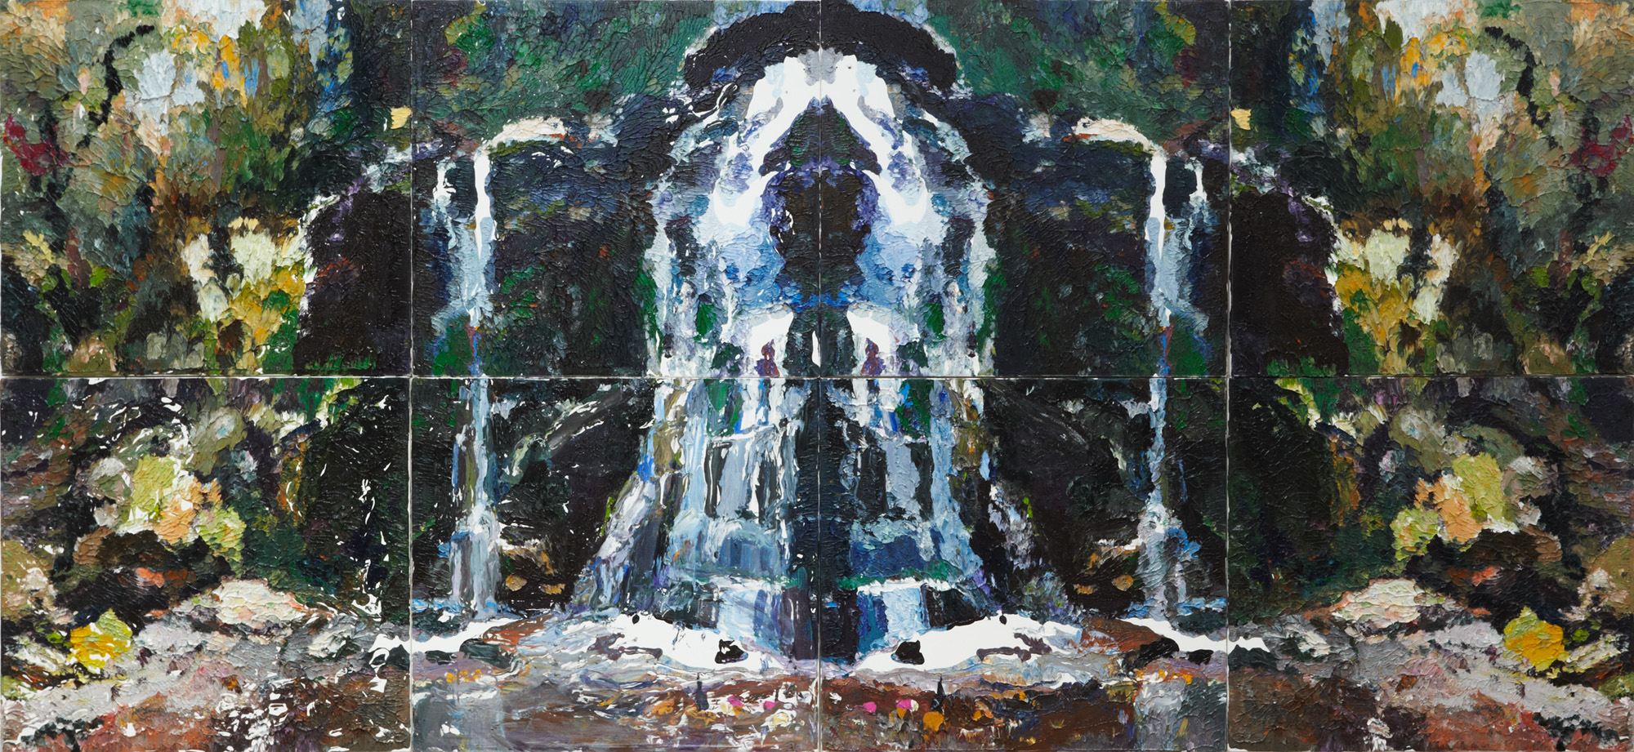
Ben Quilty, Australia, born 1973, Fairy Bower Rorschach, 2012, Southern Highlands, New South Wales, oil on linen (eight panels), 240.0 x 550.0 cm (overall); Purchased with funds provided by the Patrick White Bequest Fund, 2012, Art Gallery of New South Wales, Sydney, Courtesy the artist.
Notes:
Responding
Locate Fairy Bower Falls on a map. Look at the Colonial Frontier Massacres map collated by the University of Newcastle. What surprises you about this information? Select an event and write a newspaper article about this incident.
As a class, make a list of the public memorials you have visited or are aware of. Who do these memorials commemorate? How many of these sites acknowledge the loss of Aboriginal or Torres Strait Islander people’s lives? Why is it important to publically recognise sites like Fairy Bower Falls and those identified on the Colonial Frontier Massacre map? Write a letter to the Australian Government identifying the changes you think need to be made to recognise the Aboriginal and Torres Strait Islander lives lost?
About the work Fairy Bower Rorschach (2012) was made after Quilty discovered the violent history of an idyllic picnic spot on Gundungarra country not far from his home, where in 1834 Aboriginal women and children were reputedly massacred. Fairy Bower Rorschach performs the double act of delusion whereby at face value a picturesque landscape, complete with waterfall, is presented but a darker story the painting’s central grotto.
The damaged and mirrored image is of a waterfall at Bundanoon in the Southern Highlands of New South Wales near where Quilty lives and works. Fairy Bower Falls is an idyllic and spectacular destination for tourists and locals. Photographs from the mid 19th century depict the full colonial splendour of women with parasols and men in top hats at the foot of the falls.
By Rorschaching this image of such a precarious site Quilty asks the viewer to reconsider their conception of this landscape as a place of idyllic beauty. The duplication and damage of the image echoes the disturbing and violent history this site may have witnessed’.
- Dr. Lisa Slade, Quilty exhibition room guide, 2019.

Slide 24
‘With most art if it’s a beautiful thing that tells a dark story, it can’t be more powerful’.
Ben Quilty on ‘When Silence Falls’, 2016
Notes:
Responding
Quilty acknowledges that his paintings are beautiful objects that tell a much darker story. Discuss this statement in relation to Fairy Bower Rorschach. What is Quilty suggesting about Australia’s history by using the Rorschaching technique in Fairy Bower Rorschach?
Research other artists who have made works of art about unacknowledged events such as massacres or cultural displacement. Begin by looking at the work of Vernon Ah Kee, Paddy Bedford, Rusty Peters, Freddie Timms, and Judy Watson.

Slide 25
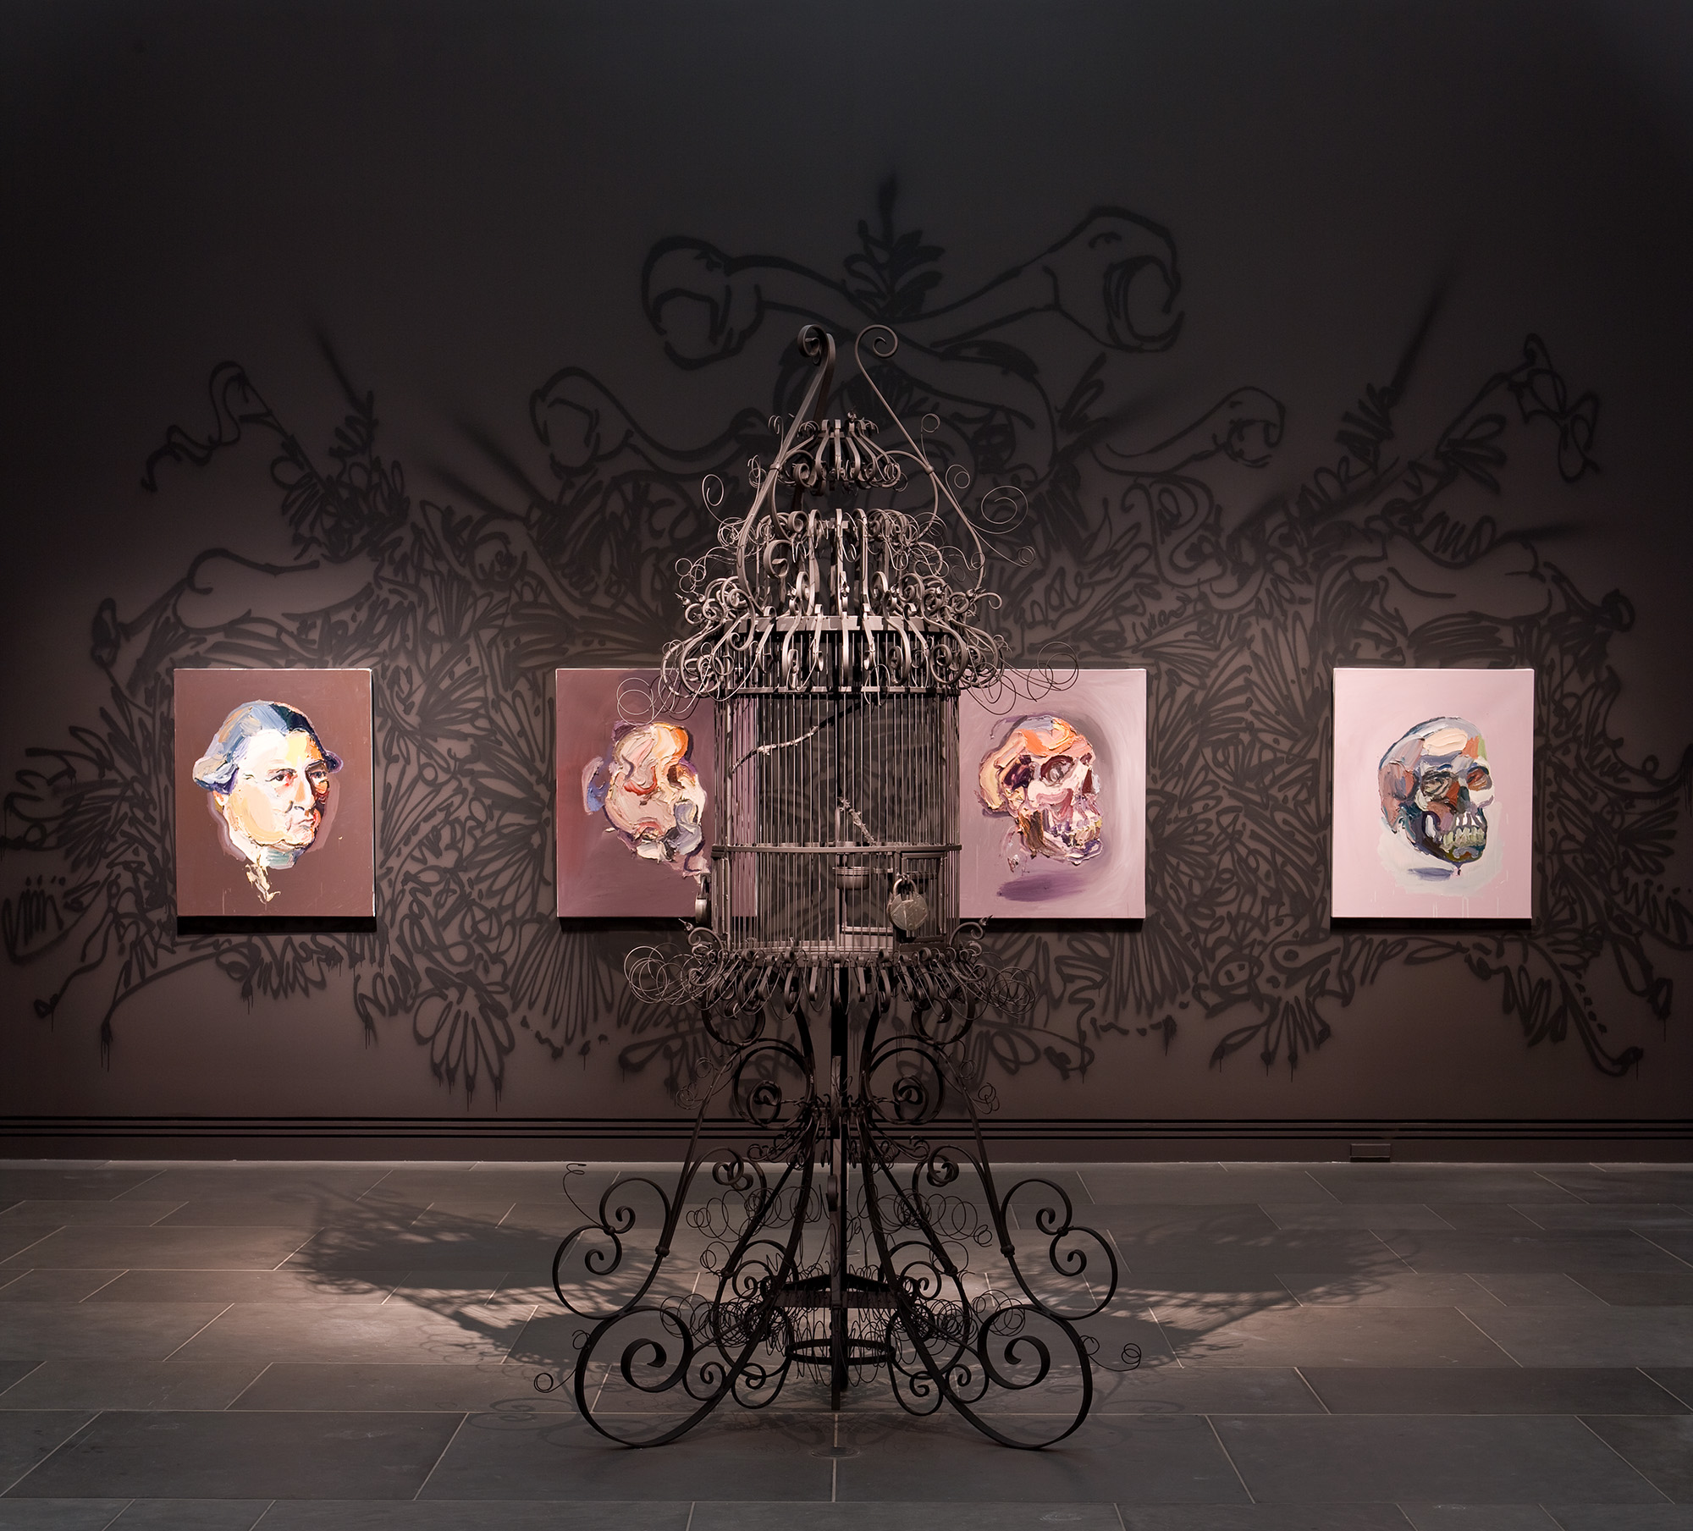
Ben Quilty, Australia, born 1973, Irin Irinji, 2018, Southern Highlands, New South Wales, oil on linen (12 panels), 224.0 x 551.0 cm; Private Collection, Courtesy the artist
Notes:
Responding
Research is an important aspect to Quilty’s practice. Select a prominent figure in Australia’s history and research their life. What aspect of their life did you find most interesting? What impact did this person have on the development of Australia or its landscape?
‘Inhabit is a series of sixteen oil paintings sequenced like cartoon cells, revealing Ben Quilty’s early training as an animator and his experience as an editor in a commercial television newsroom. The paintings progress through stages of abstraction and figuration, in which the devil emerges from a field of paint and becomes Captain James Cook (after Nathaniel Dance’s portrait commissioned by Joseph Banks), who atrophies into a skull, which becomes a portrait of the artist, who disappears into a void’.
- Dr. Lisa Slade, Quilty exhibition room guide, 2019.

Slide 26
Ben Quilty, Australia, born 1973, Evening shadows, Rorschach after Johnstone, 2011, Robertson, New South Wales, oil on linen, eight panels, 115 x 175 cm (each panel), 230 x 702 cm (overall) Gift of Ben Quilty through the Art Gallery of South Australia Contemporary Collectors to celebrate the 10th anniversary of Contemporary Collectors 2013. Donated through the Australian Government's Cultural Gifts Program, Art Gallery of South Australia, Adelaide, Courtesy the artist
Notes:
About the work ‘In high school, Quilty received a book on Australian landscape painting as an art prize. The book included a reproduction of Evening Shadows, Backwater of the Murray, South Australia, painted in London in 1880 by H.J. Johnstone. Quilty recalls being seduced by the painting’s romanticism yet troubled by the accompanying interpretation of the painting offered in the book. A late-nineteenth-century mash-up, Evening shadows depicts Aboriginal figures in a picturesque river landscape at twilight. By staging the scene at the end of the day, the painting reiterates an all-too-convenient and, at the time, popular allegory – the demise of Indigenous people and their traditional way of life. Evening Shadows, donated in 1881, was the first work of art acquired by the Art Gallery of South Australia.
More than 130 years on, Quilty created Evening shadows, Rorschach after Johnstone (2012) using a method inspired by Hermann Rorschach’s eponymous ink blots, introduced in the early twentieth century as a tool for psychological testing. This technique is also one that was prized by Rorschach’s contemporaries, the Surrealists – a version of their much-loved decalcomania, a technique of chance that invited free association and creative delirium. This way of working represents a perilous strategy as a painting technique – Quilty loads the canvas with impasto oil paint, only to destroy the paint surface by pressing a second unpainted canvas directly onto the first. The process – in essence a reprographic one – demands the meticulous control of paint, colour and composition, but it also invites possibility. Chance intervenes in creating accidents and abstractions that invite the viewer to reflect on their own perceptions, desires and experiences’.
- - Dr. Lisa Slade, Quilty exhibition room guide, 2019.

Slide 27
‘It’s up to the artist to tell the truth. If society were more open to embracing our rich culture, we would live in a much more interesting place’.
Ben Quilty, Dark Heart artist talk Art Gallery of South Australia, 2014
Notes:
Responding
Compare the original painting, of Evening Shadows, Backwater of the Murray, South Australia, to Quilty’s appropriation. What is different about these two paintings?
Making
Quilty uses his works of art to raise questions about Australia’s history and the stories seldom told. Investigate Australia’s history and find a story that may not be well known. Create a work of art in response to this lesser known aspect to Australia’s history.
Did you know
Evening Shadows, backwater of the Murray South Australia by HJ Johnstone was donated to the Art Gallery of South Australia in 1881 and is the Gallery’s first recorded acquisition. Evening Shadows is the said to be the most copied work of art in Australia? In 2011 artist Tom Nicholson asked South Australians to lend them their copies of Evening Shadows for the 2012 Adelaide Biennial of Australian Art exhibition.
Why do you think this painting has been the most copied work of art in Australia?
What questions do you have about the original Evening Shadows?

Slide 28
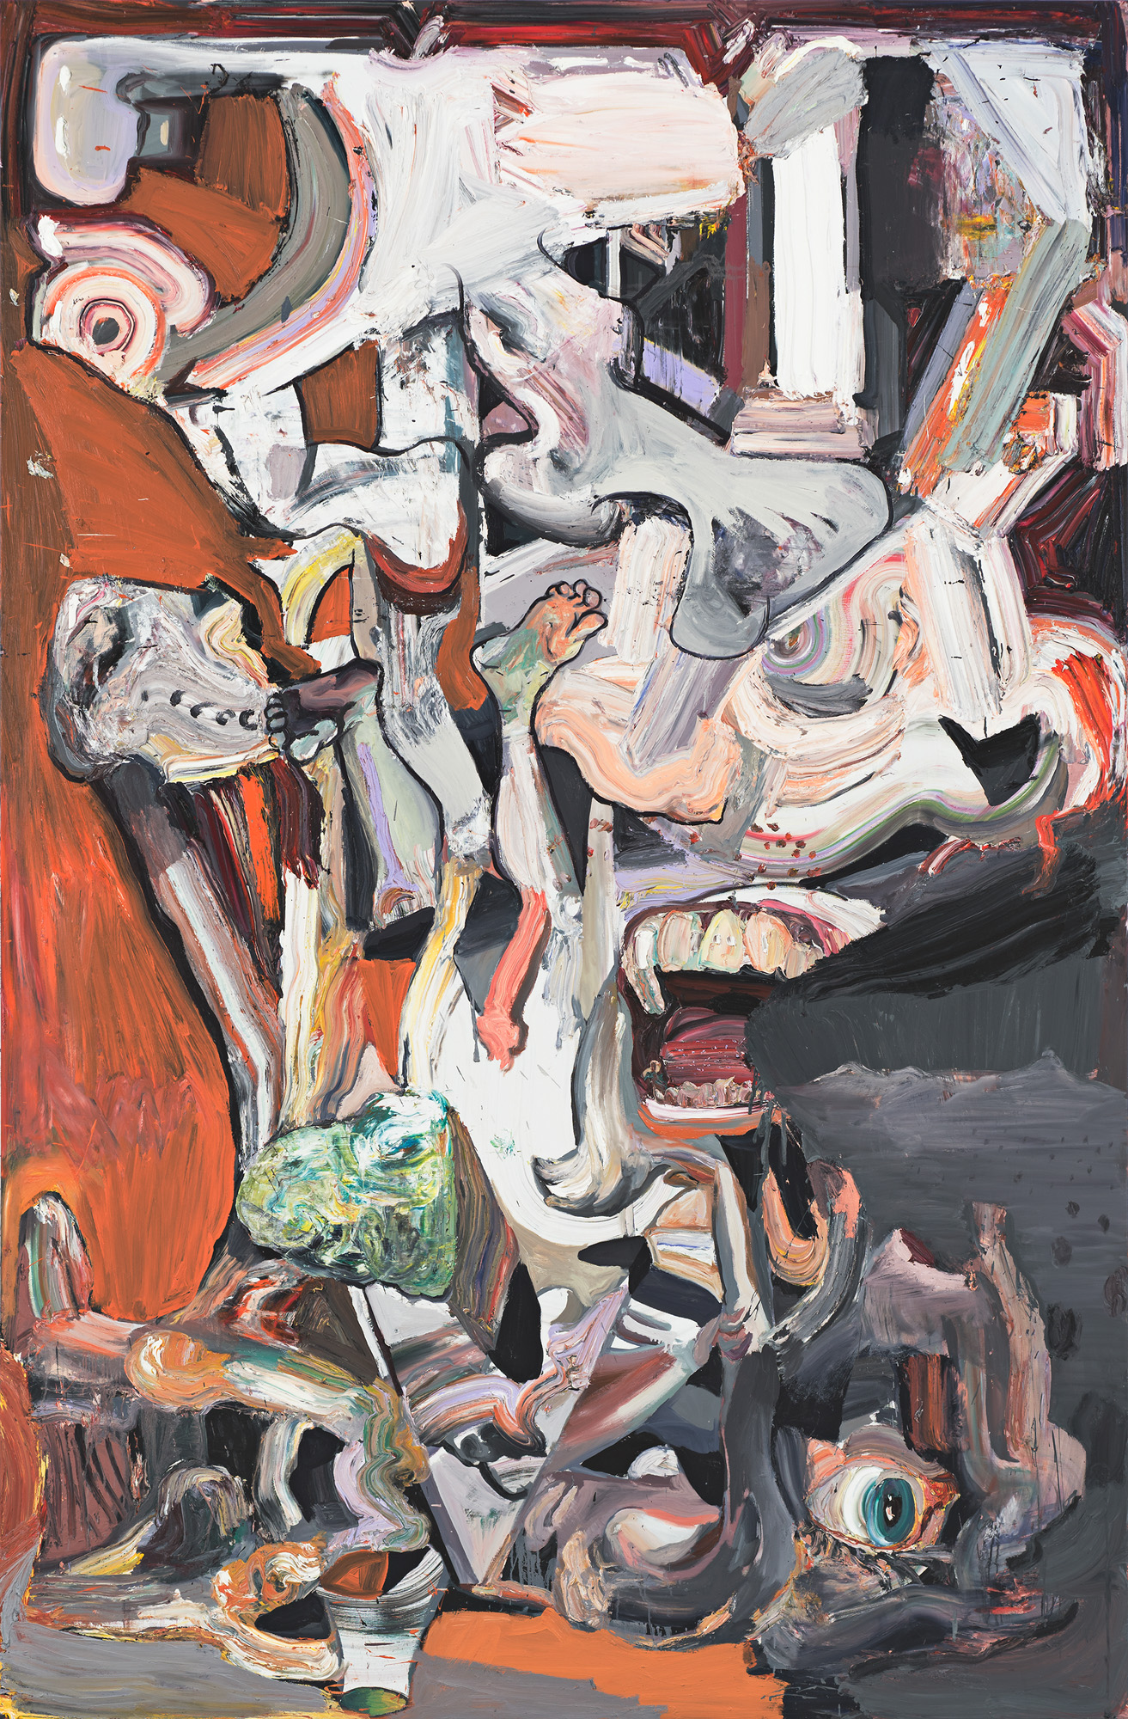
Ben Quilty, Australia, born 1973, The Last Supper no.9, 2017, Southern Highlands, New South Wales, oil on linen, 265.0 x 202.0 cm; Private collection, Courtesy the artist.
Notes:
About the work ‘This powerful painting by Ben Quilty belongs to a group of works collectively titled The Last Supper. They were painted in 2017 in response to the election of Donald Trump as President of the United States of America the previous year. The series takes its title from the Christian parable of The Last Supper, which recounts Jesus's betrayal by Judas. This subject likely struck a chord with Quilty because its themes of impending tragedy, brought about by deceit and questionable morality, chimed with his thoughts on Trump's controversial win and our current political landscape in general.
In The Last Supper 2017 Quilty confronts political turbulence and uncertainty in an epic painting that speaks of the magnitude of the situation in its imposing scale and energy. Fears and anxieties have been given expression in the picture's fragmented imagery and its thick smears of oil paint that have been slathered on the canvas with a bricklayer's trowel. The result is a harrowing depiction of chaos, as the artist attempts to come to terms with a world that at times seems to be going mad’.
- Art Gallery of New South Wales, online collection

Slide 29
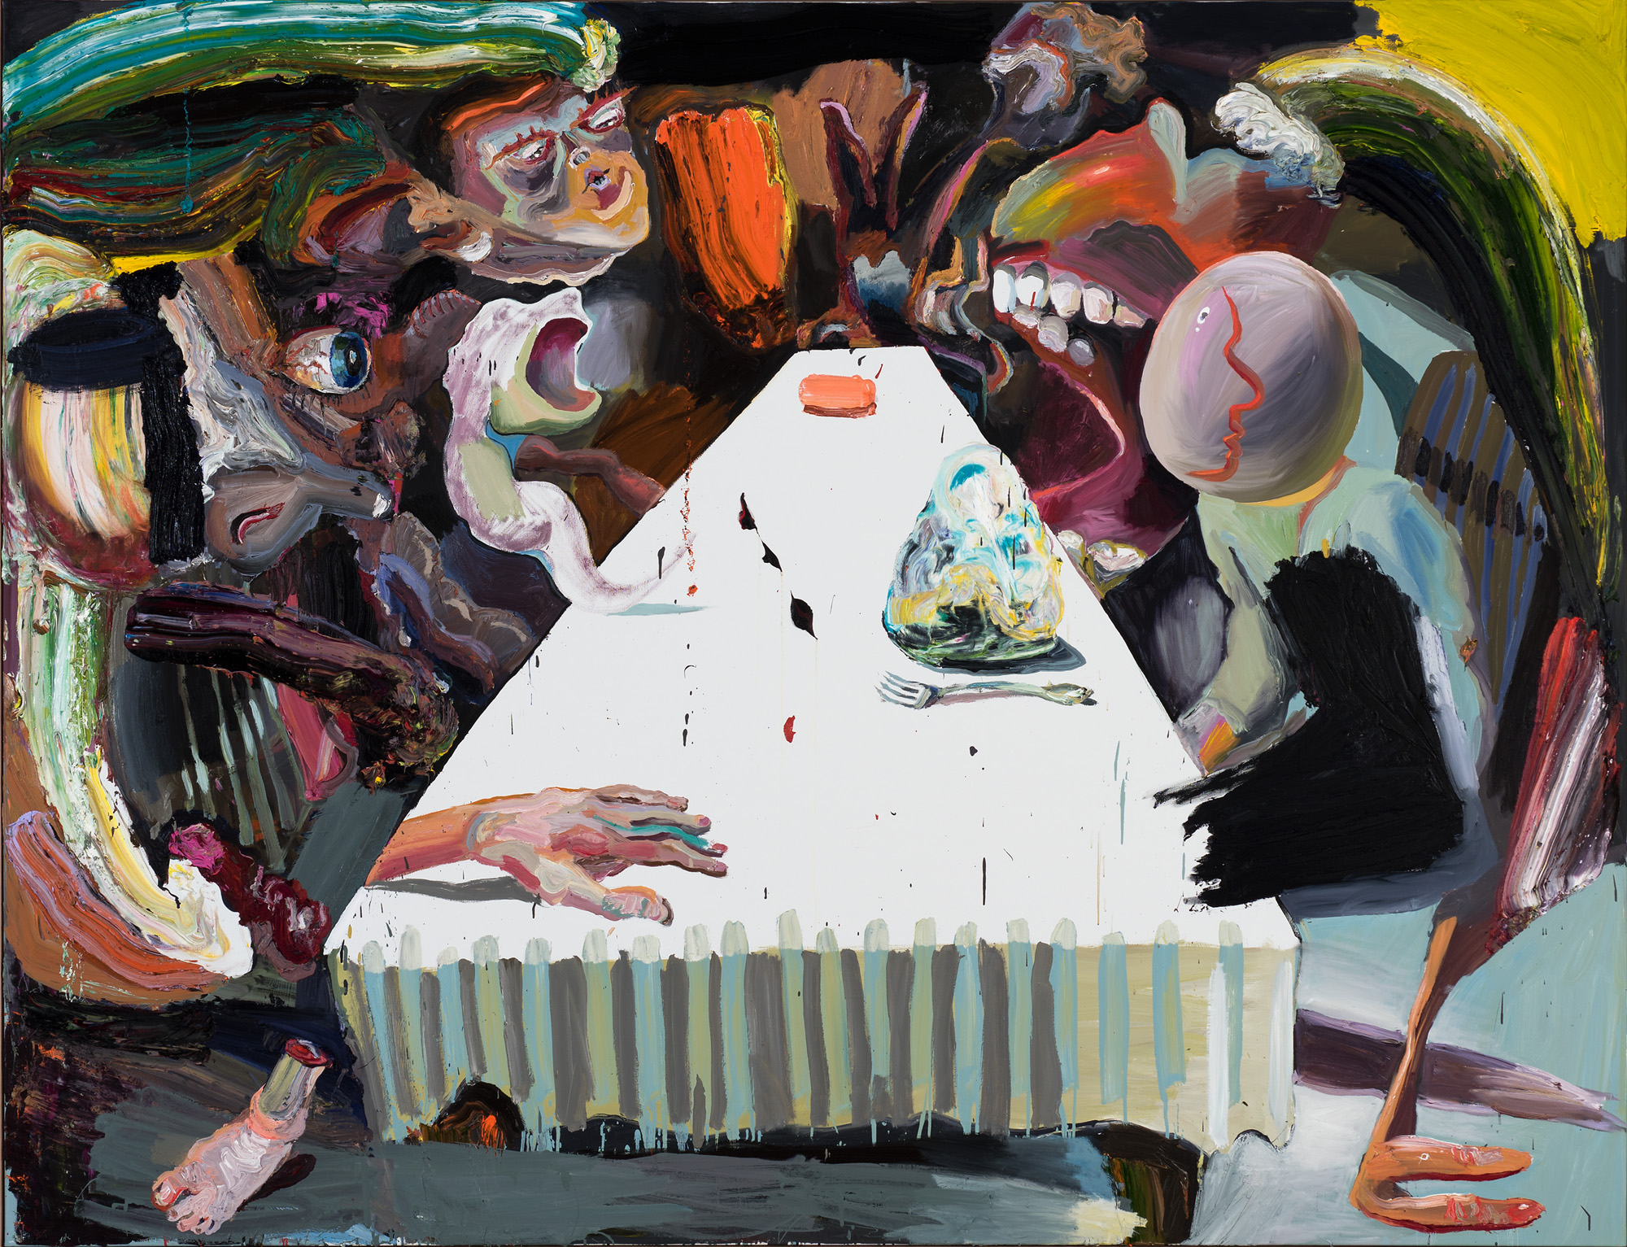
Ben Quilty, Australia, born 1973, The Last Supper, 2016, Southern Highlands, New South Wales, oil on linen, 204.0 x 267.0 cm; Private collection, Courtesy the artist.
Notes:
Responding & Making Look at the works The election (p. 289), or Bipartisan (p. 295), or The truth (p. 291), or A bad year (p. 292) (all painted in 2017) in the Quilty book, 2019.
The titles of these paintings tell us that Quilty was thinking about ‘current affairs’. What events do you think he was referring to?
What do they suggest about Quilty’s feelings or attitudes towards these events?
Create a work of art in response to current affairs in Australia.

