Slide 2
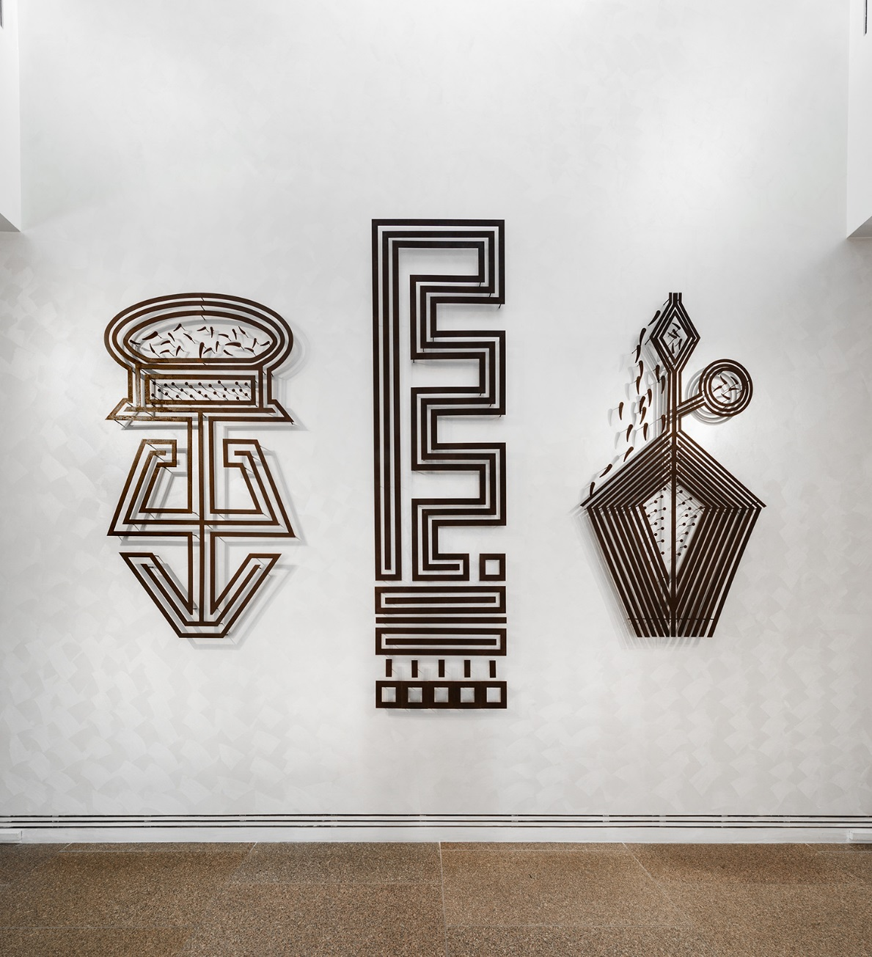
Darrell Sibosado
Darrell Sibosado is a Bard man of the Lombadina Community in northern Western Australia. His work reflects the traditions of the Bard people, such as the engraving of riji designs on guwan pearl shells found on the coast of the Dampier Peninsula.
He is inspired by the traditional riji clan designs that he learnt from his uncle, who was a renowned riji carver. He uses contemporary tools and materials to continue this tradition. His large steel riji designs represent a whale, turtles, Aalingoon the Rainbow Serpent and humpback whale.
Darrell Sibosado, Bard people, Western Australia, born 1966, Port Hedland, Western Australia, Aalingoon (Rainbow Serpent), 2019, Lombadina, Western Australia, corten steel, 210.0 x 120.0 cm, 298.9 x 85.0 cm, 210.0 x 120.0 cm; © Darrell Sibosado

Slide 3
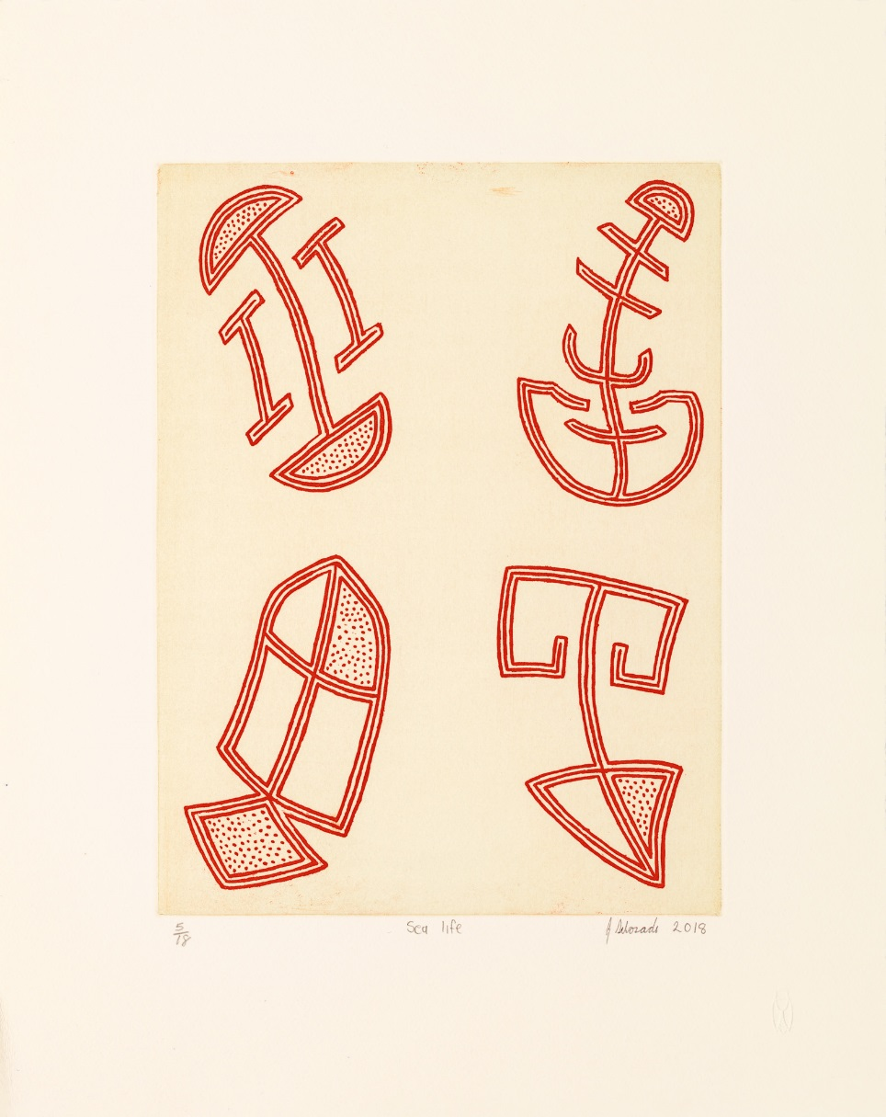
Riji pearl shells
Pearl shells (Pinctada maxima), known as guwan in the Bard language, are found in an isolated region of north-west Australia. Traditionally the shells are worn by men, often during ceremonies, and were traded with other Aboriginal peoples.
Once the shells have been carved with patterns, polished and rubbed with ochre, they are called riji. The riji designs relate to the law of the Bard people and represent different animals from the sea, such as whales, turtles and dolphins.
Garry Sibosado, Bard people, Western Australia, born 1974, Derby, Western Australia, Sea Life, 2018, Cicada Press, University of New South Wales Art & Design, Sydney, etching, 25.2 x 35.5 cm (image); 40.0 x 50.5cm (sheet); © Garry Sibosado.

Slide 4
‘Darrell has always had the urge to experiment with different materials to re-create and represent riji designs as well as other designs on a larger scale.’
Tess Allas, Director, Indigenous Programs, University of New South Wales, in Tarnanthi publication, 2019

Slide 5
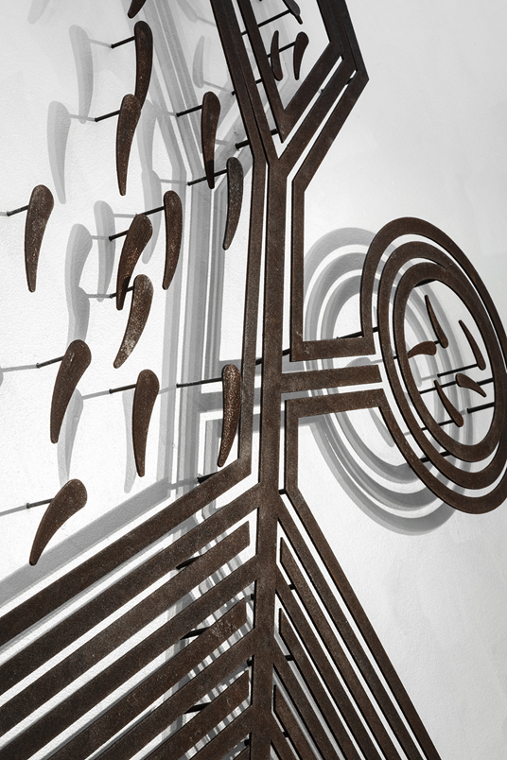
Early Years and Primary Tradition and Materials
Darrell Sibosado uses contemporary materials and techniques to express traditional designs.
What are some of your family or school traditions? Why are traditions important?
Look closely at Darrell Sibosado’s work and the carved shellwork of his brother Garry Sibosado. What similarities can you identify in the designs? How does the design change when different materials or surfaces are used?
The riji designs refer to different animals from the sea, such as whales, turtles and dolphins. Think about your personality and characteristics. If you were an animal, what animal would you be and why? Create a design that represents this animal.
detail: Darrell Sibosado, Bard people, Western Australia, born 1966, Port Hedland, Western Australia, Aalingoon (Rainbow Serpent), 2019, Lombadina, Western Australia, corten steel, 210.0 x 120.0 cm, 298.9 x 85.0 cm, 210.0 x 120.0 cm; © Darrell Sibosado.

Slide 6
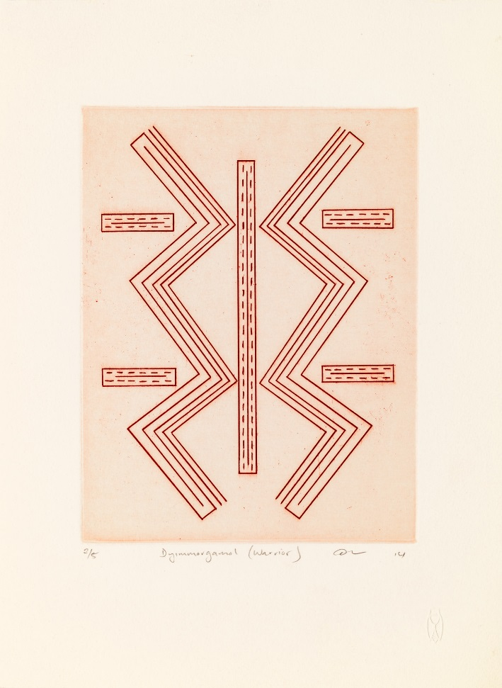
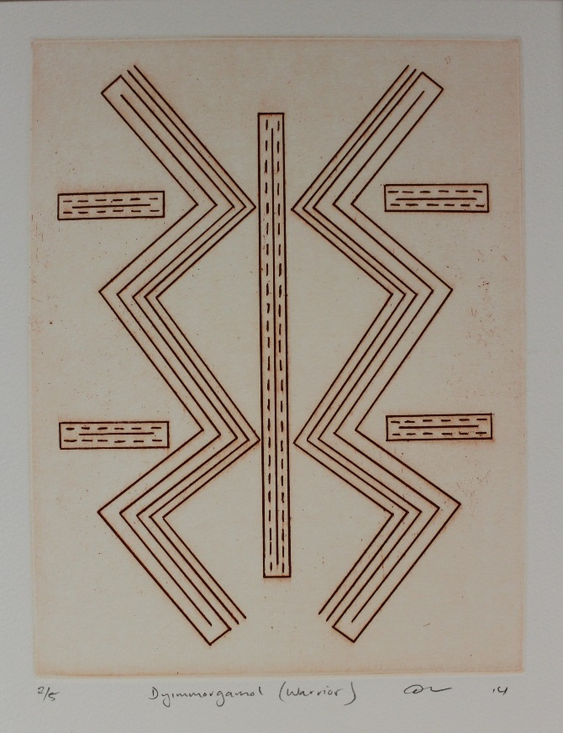
Primary Patterns
Darrell Sibosado has enlarged his designs by using steel as well as creating the same designs using etchings. Which do you prefer, the printmaking or the steel structures, and why? What impact does a different choice of media have on the audience?
Darrell Sibosado uses bold design elements in his work. What other words can you use to describe Sibosado’s work?
Photograph marks and patterns found in nature. Reduce and simplify these patterns to create a geometrical or symmetrical design. Experiment with wire to create a three-dimensional design.
Investigate fractals (never-ending designs). Where are they found and how are they are formed? Can you transform your design from the previous activity into a fractal?
Reko Rennie uses bold geometric patterning inspired by his Kamilaroi heritage in his large-scale mural work OA_CAMO (located between gallery 17 and 5). What are the similarities and differences in the visual elements and approaches of Rennie and Sibosado?
Darrell Sibosado, Bard people, Western Australia, born 1966, Port Hedland, Western Australia, Dyimmorgamol (Warrior), 2014, Cicada Press, University of New South Wales Art & Design, etching, © Darrell Sibosado.

Slide 7
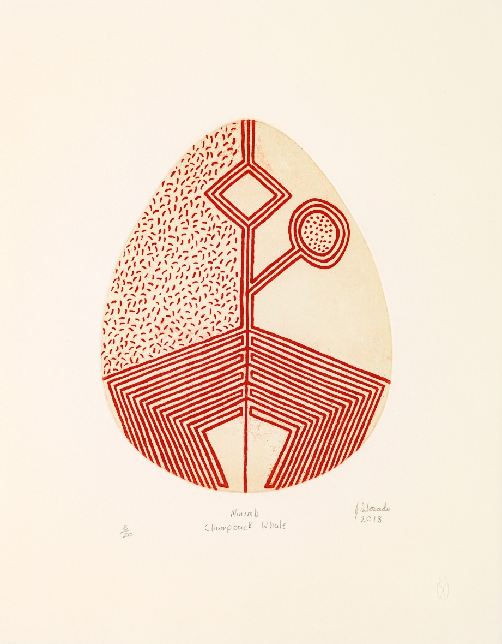
Primary Creation Stories
According to the story of Aalingoon (the Rainbow Serpent), the pearl shells are the scales of the Serpent when it sheds its skin.
What other depictions of ancestral creation stories can you find in the Art Gallery?
Create a line drawing of your journey from home to school. Simplify these designs into three-dimensional sculptures. Experiment with hanging the designs on a wall or placing them in different environments.
Create enlarged cardboard cut-outs of shapes and patterns found in the sea or near the ocean. As a class, join your shapes together to create a collaborative sculptural work. Tip: Experiment with cutting grooves into the cardboard so that your shapes can slot into each other, making your sculpture freestanding.
Garry Sibosado, Bard people, Western Australia, born 1974, Derby, Western Australia, Minnimb (Humpback whale), 2018, Cicada Press, University of New South Wales Art & Design, Sydney, etching, 22.5 x 29.0 cm (image); 40.0 x 51.0cm (sheet); © Garry Sibosado.

Slide 8
‘As a contemporary Bard man who embodies the Aalingoon creation stories, Darrell has successfully adapted these stories into the language of contemporary art, creating sculptural forms that are informed from a Bard traditional position.’
Tess Allas, Director, Indigenous Programs, University of New South Wales, in Tarnanthi publication, 2019

Slide 9
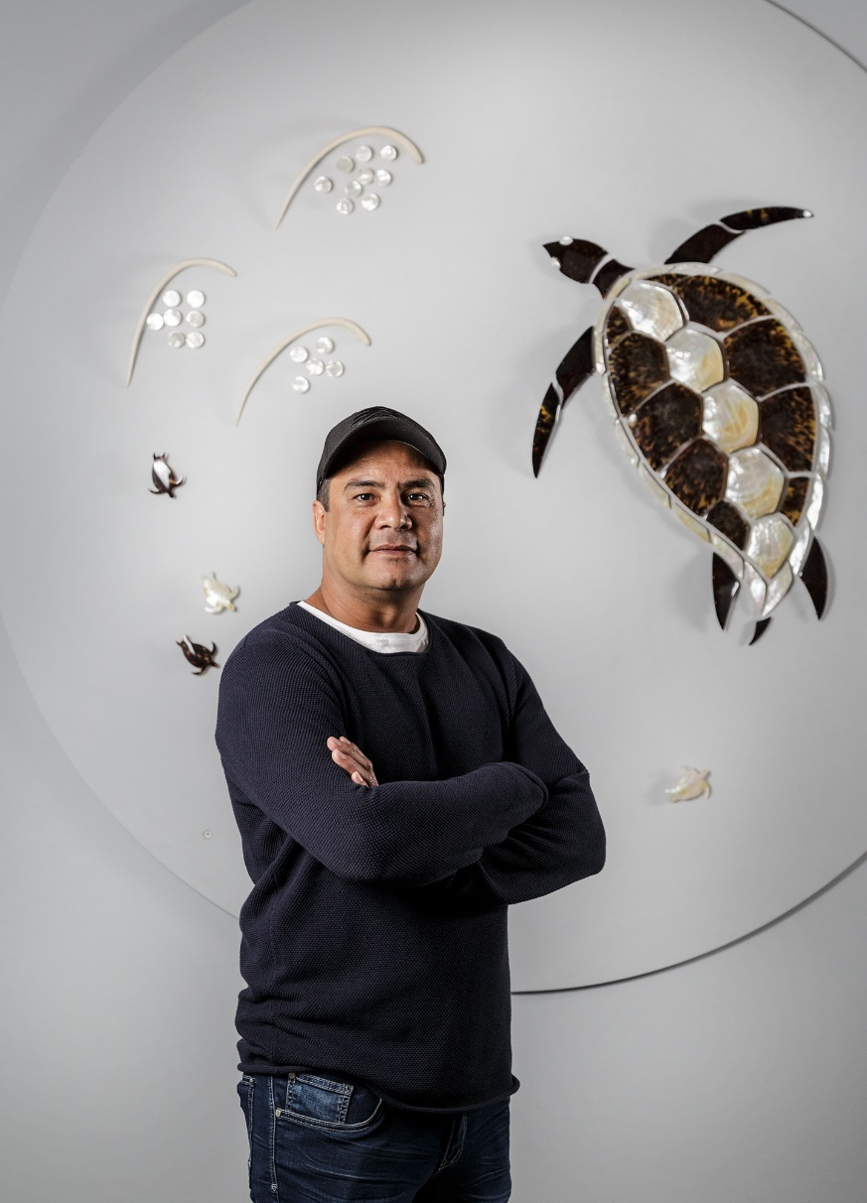
Garry Sibosado
Shell carving has been a continuous tradition among the people of the Dampier Peninsula in northern Western Australia. Darrell Sibosado’s brother Garry is also an artist who creates work inspired by traditional riji. Garry Sibosado describes his work Circle of life as ‘a story about the journey of the sea turtle as it navigates the oceans and all of its dangers. When mature enough, she will return to her birthplace to mate and lay eggs in the same sands she was born in many years ago’.
- Nici Cumpston, Curator of Aboriginal and Torres Strait Islander Art
Garry Sibosado with his work Circle of life, Tarnanthi 2019, Art Gallery of South Australia, Adelaide; photo: Saul Steed.

Slide 10
The Rainbow Serpent
Darrell Sibosado’s brother Garry is also an artist who creates work inspired by traditional riji. His work Aalingoon (Rainbow Serpent), 2018, is about a well-known Aboriginal creation story.
‘The story of Aalingoon, the Rainbow Serpent, is one of the most important of all Bard creation stories. Each full moon, when it is time for Aalingoon to shed its skin, it does so by resting on the surface of the ocean and dropping and scattering scales, which become the pearl shells found in the waters that surround the Dampier Peninsula. These shells have been and continue to be used by Bard carvers who incise and ochre the shells with designs and stories, which have long been associated with the Sibosado family.’
Tess Allas, Director, Indigenous Programs, University of New South Wales, in Tarnanthi publication, 2019
detail: Garry Sibosado, Bard people, Western Australia, born 1974, Derby, Western Australia, Aalingoon (Rainbow Serpent), 2018, Lombadina, Western Australia, earth pigments on engraved pearl shell, 180 x 20 cm; © Garry Sibosado, photo: Jalaru Photography.

Slide 11
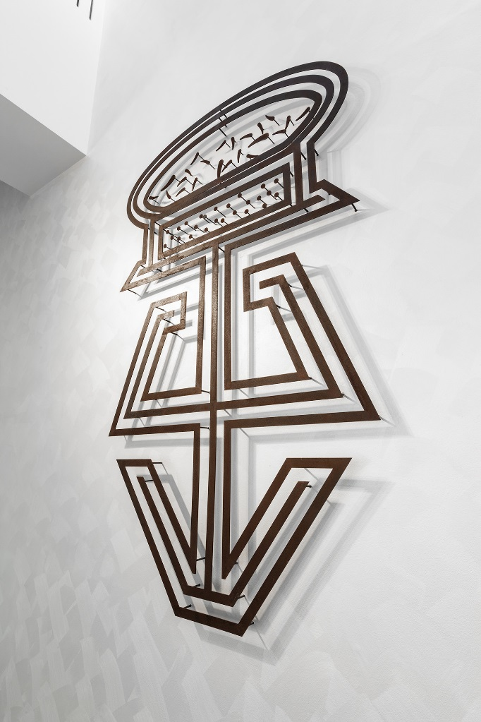
Early Years and Primary The Kimberley Region
The Kimberley region is home to 200 communities and 30 Aboriginal peoples with different languages.
Locate the Kimberley region on a map.
Can you identify the different nations or language groups in the region, including the Bard people? Tip: Use the AIATSIS map to locate this information.
What is the landscape like in Lombadina where Sibosado is from?
What plants and animals might you find there?
How is the environment of Lombadina represented in Sibosado’s works of art?
Aboriginal and Torres Strait Islander people throughout Australia experience many different seasons.
Research how these seasons differ from the four seasons recognised by Europeans.
What are the seasons in the Kimberley? What happens during these seasons? Find out more about the Aboriginal names and descriptions of seasons where you live and display these in your classroom.
detail: Darrell Sibosado, Bard people, Western Australia, born 1966, Port Hedland, Western Australia, Aalingoon (Rainbow Serpent), 2019, Lombadina, Western Australia, corten steel, 210.0 x 120.0 cm, 298.9 x 85.0 cm, 210.0 x 120.0 cm; © Darrell Sibosado.

Slide 12
People need to realise that Australia is like going to Europe. In Australia, there are different clans, different tribes, different languages.
Darrell Sibosado, Tarnanthi 2019 portrait video

Slide 13
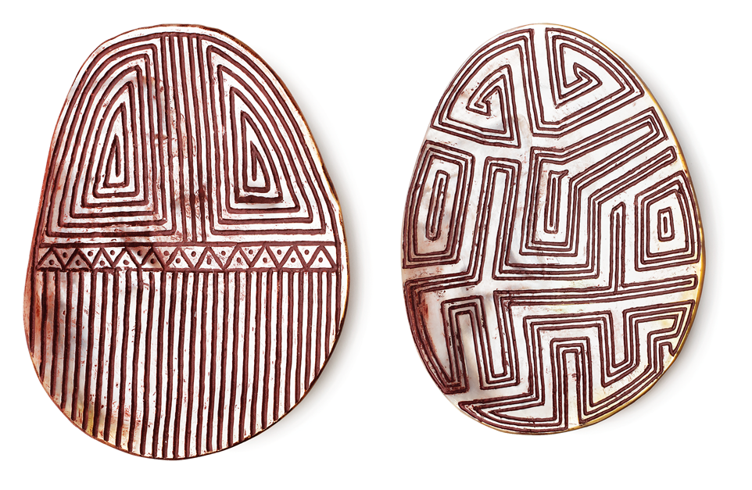
Primary and Secondary Metal and Shell work
Sebastian Arrow is a Yawuru artist from Broome in the Kimberley. Like Darrell and Garry Sibosado, Arrow also uses riji shell designs. What differences can you observe when comparing the different clan designs? How has each artist expressed their individuality while using similar techniques? Tip: Sebastian Arrow’s work is on display in gallery 2.
Select a logo you know well, such as your school or sporting team emblem. Deconstruct the logo by identifying the key shapes, colours and lines. Using these elements, create a new composition. Compare your design with your classmates’ logos. How have different students interpreted the logo? How many new logos can be created using the same elements?
Sebastian Arrow, Yawuru people, Western Australia, born 1994, Broome, Western Australia, Jalinyi, Jalinyi, 2015, Perth, carved pearl shell, red earth pigments, 19.0 x 14.5 cm, 18.0 x 14.0 cm; Acquisition through Tarnanthi: Festival of Contemporary Aboriginal & Torres Strait Islander Art supported by BHP 2016, Art Gallery of South Australia, Adelaide, Image courtesy of Sebastian Arrow and Short St Gallery.

Slide 14
Primary and Secondary Metal and Shell
In the Tarnanthi portrait video, Darrell Sibosado states: ‘I feel very comfortable using contemporary materials because they are the materials I know now. That’s the way our culture is, you use what’s in your environment.’
Yolŋu artist Gunybi Ganambarr uses materials found on the land, such as discarded building materials, lengths of worn-out conveyor belt from a nearby mine and pieces from an old water reservoir at his community of Gäṉgän. Ganambarr cuts, grinds, etches and paints his miny’tji (the sacred patterns belonging to clans) onto the objects he finds.
Compare the metal work by Ganambarr to the metal and shell work by the Sibosado brothers. What is similar about the works of art and the artists’ approach to their practice?
Sibosado draws inspiration from his elders. Create a work of art on a found object inspired by your family and where you are from.
Gunybi Ganambarr, Yolŋu people, Northern Territory, born 1973, Yirrkala, Northern Territory, Gäṉgän, 2019, Yirrkala, Northern Territory, etching on aluminium, 150.0 x 150.0 cm; © Gunybi Ganambarr/Buku-Larrŋgay Mulka Centre.
Sgraffito means ‘to scratch through’. Both Ganambarr and Sibosado have applied this technique, Ganambarr with his metal work and Sibosado with his etchings and riji. Create a unique design that represents your family. Experiment with the sgraffito technique. Apply one layer of paint onto paper or canvas board. Paint a second layer over the top with a different colour. Draw your design by scratching through the top layer of paint. Tip: Try sgraffito with other mediums such as clay.

Slide 15
Secondary Connections to other shell artists
Research the techniques and processes used by different Aboriginal and Torres Strait Islander artists working with shells – for example, Sebastian Arrow, Lola Greeno, Darrel and Garry Sibosado and Esme Timbery. Tip: Lola Greeno creates traditional Aboriginal Tasmanian shell necklaces and Esme Timbery blends traditional Bidjigal shell-working techniques with contemporary designs.
Write an essay in response to the following statement: ‘Aboriginal and Torres Strait Islander peoples are diverse, and their art is too’. Use a variety of artists to support your argument.
Lola Greeno, Trawlwoolway people, Tasmania, born 1946, Cape Barren Island, Tasmania, Necklace, 2001, Launceston, Tasmania, maireener shells, 206.0 cm circumference; Rhianon Vernon-Roberts Memorial Collection 2001, Art Gallery of South Australia, Adelaide, Courtesy the artist

Slide 16
Secondary Curate your own exhibition
Darrell Sibosado co-curated the exhibition Shimmer Shellwork with Tess Allas and Tahjee Moar at the Wollongong Art Gallery. The exhibition explored Aboriginal and Torres Strait Islander shellwork.
Curate your own digital exhibition featuring Aboriginal and Torres Strait Islander artists based on a theme. Present your hypothetical exhibition to the class, providing reasons for your selections.
Useful Link: ‘Exhibitions/Shimmer Shellwork’, Wollongong Art Gallery, http://bit.ly/2mqd46O
Darrell Sibosado, Bard people, Western Australia, born 1966, Port Hedland, Western Australia, Aalingoon (Rainbow Serpent), 2019, Lombadina, Western Australia, corten steel, 210.0 x 120.0 cm, 298.9 x 85.0 cm, 210.0 x 120.0 cm; © Darrell Sibosado

Slide 17
Secondary Sustainability
The collection and use of pearl shells has now been limited to ensure future sustainability of the marine life.
Investigate sustainable practices used by Aboriginal and Torres Strait Islander peoples.
Research different approaches to caring for the marine environment. What strategies have been implemented near the waterways in your local area? Create an installation that uses recycled materials and celebrates the health of marine life.
detail: Darrell Sibosado, Bard people, Western Australia, born 1966, Port Hedland, Western Australia, Aalingoon (Rainbow Serpent), 2019, Lombadina, Western Australia, corten steel, 210.0 x 120.0 cm, 298.9 x 85.0 cm, 210.0 x 120.0 cm; © Darrell Sibosado.

Slide 18
Resources
Books & Articles Richard Taylor. ‘Fractal Patterns in nature and art are aesthetically pleasing and stress-reducing’, The Conversation, 31 March 2017 http://bit.ly/2mrVboh
Sarah Collard. ‘Indigenous Kimberley artists use new tools to tell old story for Art Gallery of WA exhibition’, ABC News, 9 February 2019, https://ab.co/2koPw1m
Gina Fairley. ‘Review: Desert River Sea, Art Gallery of Western Australia’, ArtsHub, 26 February 2019 http://bit.ly/2lYaAMM
Peter de Kruijff. ‘Kimberley creativity enthrals’, The West Australian, 11 February 2019, http://bit.ly/2m4ZhCc
Videos
‘Shimmer exhibition’, Wollongong Art Gallery, Wollongong City Council http://bit.ly/2m3FQK4
Websites ‘Indigenous seasons calendars’, CSIRO Land Management http://bit.ly/2m531ne
Desert, River, Sea: Celebrating the diversity of Indigenous culture in the Kimberley http://bit.ly/2kqX4kd
Cairns Art Gallery – North by East West: Re-igniting a cultural connection through pearl shell https://bit.ly/2kZkRYT
Education resources have been developed by AGSA Education in collaboration with Nici Cumpston, Curator of Aboriginal and Torres Strait Islander Art, Dr Lisa Slade, Assistant Director, Artistic Programs, Kylie Neagle, Education Officer, Thomas Readett, Tarnanthi Education Officer, and Suzanne Close, Adelaide University Museum and Curatorial Studies Intern.

